Slide 1
East Midlands Public Health Practitioner Registration Scheme Launch
James McLean
Deputy Dean Quality and Education

Slide 2
The New World of
Transformation
STP’s
WAB’s
Vanguards
Alternative roles
Notes:
New era of acronyms and Jargon
Moving at a pace not seen before
Traditional roles challenged for the future of health care

Slide 3
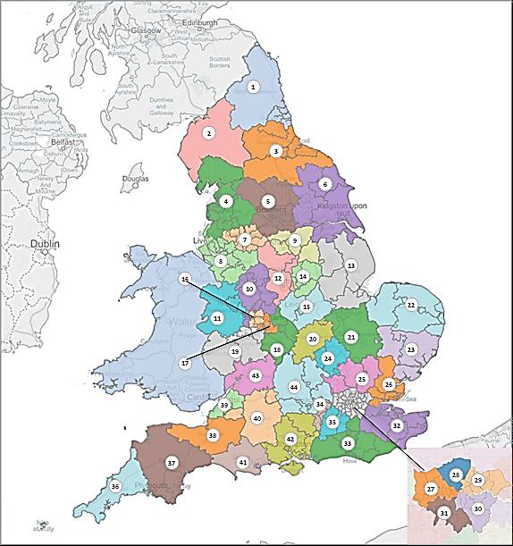
STP’s
Notes:
44 STP’s

Slide 4
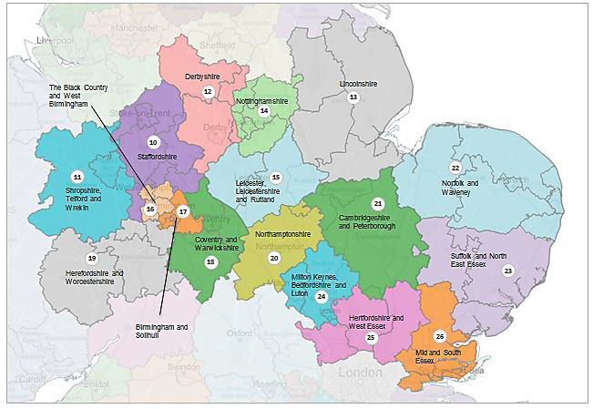

Slide 5
Qualifications
Vs
Competence
Professional Regulation
Vs
Isolation
Notes:
Public Protection is paramount it’s a sad set of lessons we have been subjected too since North staff and Winterbourne View
Competence will be paramount in the skills framework

Slide 7
Try something Different

