Slide 2
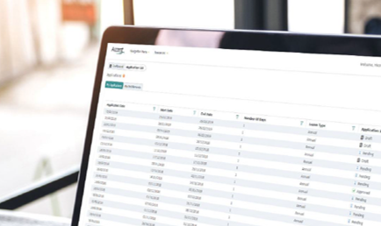
Study Leave – East Midlands
Karolina Wlodowska – Study Leave Support Officer
Notes:
Hello, I’m Karolina Wlodowska, and I’m the Study Leave Support Officer for East Midlands – I’m responsible for managing the day-to-day study leave process in East Midlands and the application system, with the support of Andy Petherbridge, the Regional Business Support Account Manager for NHSE Midlands. Following the quick introduction to study leave in East Midlands, this presentation will hopefully help to answer some of your queries about study leave and provide more details of the process.

Slide 3
Study Leave and Course Manager
Notes:
In this presentation, we’ll cover the study leave process applicable across the East Midlands, as well as an introduction to the Accent Course Manager system

Slide 4
Study Leave
Overview of East Midlands Study leave process
List of activities
Study leave funding
Centrally funded activities
Entitlements
Claiming expenses
Notes:
This presentation is designed to give you an overview of study leave in the East Midlands, the list of activities, funding for study leave, entitlements and how to claim expenses.

Slide 5
Study Leave Overview
Pro-rata entitlements August-August
Electronic application system (Accent Leave Manager)
Approved lists of events, courses, exams
Applicable to everyone on East Midlands training programmes
The website is: https://accent.hicom.co.uk/portal/live/web/
Notes:
[CLICK] The study leave year runs in line with the standard training year of August to August. This means that if you start or finish training part-way through the year, go Out of Programme, or work less than full-time, you receive a pro-rata entitlement of study leave days, just like with annual leave. [CLICK]
In the East Midlands we use an online application system called Accent Leave Manager. The advantages of using an online system is that everything’s set up for you; your rota coordinators and TPDs are set up as approvers for all of your posts no matter where you are in the region, and can approve your leave by simply logging into their own accounts. [CLICK]
There’s also a list of ‘pre-approved’ activities built into the system that have been agreed by your TPDs; I’ll cover this in more detail later. [CLICK]
The Leave Manager system is used by all of you across East Midlands programmes, and in all hospitals, so you should have the same experience no matter where you rotate. The same system is now also being rolled out across the country, meaning all NHSE local offices will soon be using Accent Leave Manager for study leave management.
The website for Leave Manager is on the screen; please make sure that you go to this link.
So how do you get access to funding? [CLICK]

Slide 6
Entitlements
Made up of days (curriculum required and discretionary)
Curriculum required: activities explicitly mandated as part of the curriculum e.g., exams. May also include Curricular support activities specified by the programme
Discretionary: activities suggested extra-curricular activities that may benefit learners development. Includes private study leave (exam revision time)
Leave Manager keeps a running total and only allows applications up to the remaining entitlement
Adjusted if you start/leave/reach CCT part way through the year or go on maternity leave or OOP
Notes:
Leave Manager works on the concept of entitlements. We’ll talk about financial entitlements in a bit, but we’ll start with your entitlement of study leave days. These are split into curriculum required and discretionary days; [CLICK]
Curriculum required activities are usually activities run by either your School, or by NHSE this will include locally delivered teaching; for example, weekly afternoon teaching and monthly regional teaching and any protected teaching time within job plans. This also includes exams which are required for the curriculum. [CLICK]
Discretionary leave covers everything else; events outside of the region not required for the curriculum, private leave for exam revision and any other activities not required for the curriculum but those that support the overall development. There is flexibility, with the approval of your TPD, to amend your curriculum required/discretionary split of days – if you feel that your split doesn’t reflect your needs for the year, please discuss this with your TPD. [CLICK]
You can check your entitlements at any time by going to the My Entitlements section of your account. Leave Manager will only allow you to submit leave applications up to your remaining entitlement, so it’s important to plan what you need study leave for early in the year. [CLICK]
Unlike budgets, study leave days are pro-rata; if you train less than full time, start or finish training part-way through the year, or go out of programme for any reason, this will affect your entitlement for that year. In certain circumstances, there may be the opportunity to increase pro-rata’d entitlements depending on individual needs; again, if you feel that this applies to you, please discuss with your TPD at the earliest opportunity.

Slide 7
Notes:
So let’s walk through a high-level overview of the leave approval process in Leave Manager.
You submit your leave request on Leave Manager, including an estimate for your expenses. These estimated expenses don’t need to be precise, but should cover what you expect to spend.
This request is automatically directed to the appropriate rota coordinator based on your post number – if you’re in Paediatrics at QMC, it’ll get directed to the QMC Paediatrics approver; if you’re in Gastroenterology at Leicester Royal, it’ll get directed to the Leicester Royal Gastro approvers – it’s that simple. You can also see who has approved your request, and whose approval is still pending, on your leave request at any time by opening the request in the My Applications section of your account and scrolling down to the Approvers section.
The rota approver will receive an email notification of your request.
If the rota approver rejects the request for any reason, then Leave Manager will email you to confirm this, along with the reason given by the approver.
Assuming that everything is fine and they approve it, then the request progresses to the next stage – I’m going to take a minute here to talk about the difference between Curriculum Required and Discretionary activities.

Slide 8
List of activities
Schools/Programmes confirm which events are applicable to you and whether they are ‘curriculum required’, ‘curricular support’ or ‘discretionary’
When you apply, Accent Leave Manager does all the calculating
Approval of time off by rota coordinator/JDA/Practice Manager/local equivalent (Standard application)
Can also submit requests for discretionary activities (Exception application)
Approval of suitability by TPD
Notes:
NHSE is committed to supporting you with study leave time and expenses for activities that directly support your curriculum requirements. [CLICK]
Your TPDs have provided a list of pre-approved activities which are required for your curriculum, which can include courses, and exams. These can be applied for with only approval from your rota coordinator, JDA, or local equivalent. [CLICK]
When you apply for an activity, Leave Manager does all of the calculating for you, so you don’t need to remember which activity falls into which entitlement. [CLICK]
Your TPDs have also included some suggested activities that support you demonstrating curriculum-required competences but which could be achieved in other ways (known as curricular support activities), and suggestions for activities that you may want to consider as part of your development beyond the standard curriculum (known as discretionary activities). These discretionary activities are neither comprehensive nor necessary; they are just suggestions that may help you develop your PDP for the year if they’re in line with your career goals.
Discretionary activities can be applied for by submitting an ‘Exception’ application; to do this, you just need to check the box that indicates the event is not on the approved list and either select the appropriate activity from the new drop-down menu, or manually type in the name of the activity that you wish to attend.
The only difference between a standard request and an Exception request is that a standard request, is approved as soon as your rota coordinator authorises it. An Exception request, is approved by your rota coordinator for time off and is then automatically passed on to your TPD, who will decide if it’s suitable for you to attend at your current stage of training and if the expenses can be fully supported. A full list of the activities can be found on our website.

Slide 9
Notes:
Back to our overview, assuming that everything is fine with the leave request and the rota approver authorises the request, then it progresses to the next stage.
If it’s a Standard leave request, so something that’s on the approved courses list as a Curriculum Requirement, then that’s it – Leave Manager will email you, and the approvers for reference, to confirm that the request has been approved. If it’s an Exception request, ie not a Curriculum Requirement on the approved list, then it goes to the Exception approver.
This is determined based on the Programme that post is assigned to rather than the site or specialty – so a request from a Core Surgery doctor in a Urology post will go to the Core Surgery TPD, while a request from a Urology doctor in the same department will go to the Urology TPD, even if the rota approver was the same person.
So once again, if the Exception approver rejects the request for any reason, then Leave Manager will email you to confirm this, along with the comment.
Assuming that everything is fine and it’s approved again, then the request is done for now – Leave Manager will email you, and the approvers for reference, to confirm that the request has been approved.
Now, Leave Manager doesn’t offer the option for you to just change your request after it’s submitted; this is to help prevent confusion over rotas, spending, anything like that. You can submit a cancellation for your leave request, but this isn’t always necessary. As we suggest on our website, if it’s just that you need to add or amend your expenses or the number of days, you can contact our team and we’ll update your application for you. If there’s a significant change in the costs you want to claim, we might need to confirm with your TPD or Head of School to make sure they’re aware and supportive, but assuming that there’s no concerns, and/or the request has been approved by the relevant parties, we’ll update Leave Manager and you can take your leave and claim your expenses without issue.

Slide 10
Study leave funding
Funding is available for:
Curriculum-Required (explicit curriculum requirements)
Curricular support (support the achievement of curriculum competences, but not necessary to attain those competencies)
Discretionary (non-curricular activities)
Apply on Leave Manager (https://accent.hicom.co.uk/Portal/Live/Web/)
No set individual budget within Leave Manager – threshold approval above an application total of £1000
Continue to apply for reimbursement from employer or separate reimbursement arrangement: www.eastmidlandsdeanery.nhs.uk/policies/study_leave/ResourcesGuidance
Notes:
So as mentioned, NHSE will cover the appropriate costs for your curriculum-required activities, including the course fees and any applicable travel, accommodation or food in line with NHS Terms & Conditions of Service rates. But there is also funding available for [CLICK] Curricular support activities, which are activities that may support you achieving curriculum required competences, but aren’t required courses themselves, and [CLICK] Discretionary activities, which are activities that don’t directly relate to your curriculum, but support your overall development as a doctor, such as specialist interests, as long as you’re achieving your curriculum requirements. [CLICK]
There is no set individual budget for learners on secondary care placements; however a threshold approver (HoS) is triggered if an application includes expenses above £1000. Programmes with set budgets are listed in the Study Leave policy. [CLICK]
There is no maximum amount that an individual can claim; however the threshold approver has a responsibility to monitor spend within the School to review the educational benefit and value for money as well as ensuring that everyone has equitable and proportionate access – it also helps your TPD’s and Head of School better understand your training needs! [CLICK]
You continue to apply for your expenses through your employer, who will reimburse you through your pay check. Please remember that claims on Leave Manager are not paid automatically, and unfortunately NHSE cannot pay expenses directly to you; these must be claimed through your employer. Separate arrangements to reimbursements are listed on our Resource page.

Slide 11
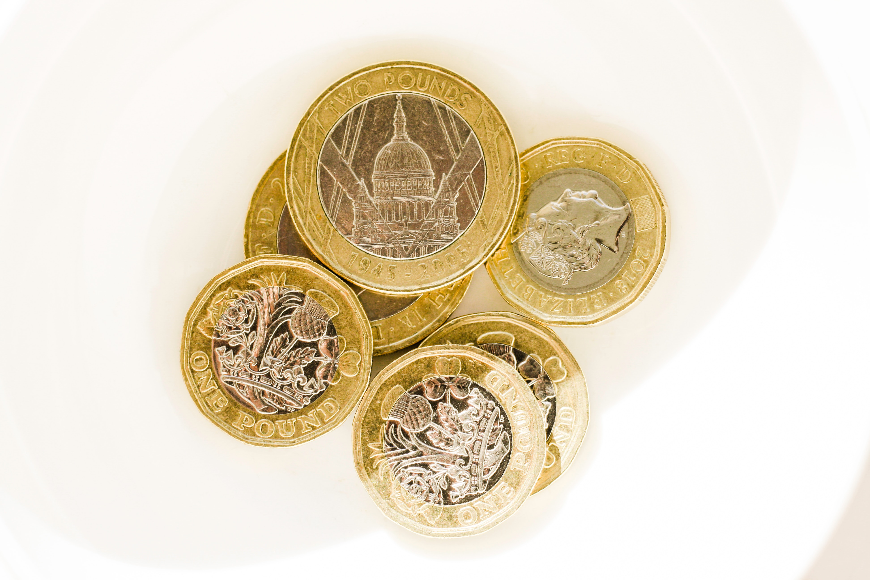
Expenses
When you apply, remember to estimate costs!
If you don’t include costs at the beginning, you may not be able to claim them back at the end
If in doubt, estimate the total cost (higher is OK but make sure it’s within your overall entitlement and the maximum rates listed in the policy).
Follow employer’s process for reimbursement – it is not paid by NHSE and is not automated.
Claim back after the leave – within 8 weeks of finishing leave or receiving approval
Notes:
On that subject, remember to include expenses with your leave request! If you don’t include expenses in your leave request, you may not be able to claim these back later. If you’re not sure what expenses to claim or how much you will be, that’s fine; it just needs an estimate. Try to be realistic about how much it’s likely to cost, but remember that expenses can only be reimbursed up to the estimated amount. There are also some standard rates, listed in the policy which are set by the NHS Terms and Conditions of Service – so please make sure that you take a look before applying.
After your leave has taken place, you need to follow your employer’s process for reimbursement; it’s not done directly through Leave Manager, and NHSE can’t pay you directly.
This should happen within 8 weeks of the course taking place or receiving approval on Leave Manager.

Slide 12
Notes:
This flow chart further shows the steps in the reimbursement process. Please note that for some programmes this may vary and any exceptions are listed on our Resource page with step-by-step guidance. If you have any queries relating to the reimbursement process or progress of a submitted claim or payment, please contact your local Study Leave Coordinator at the Trust or GP Programme. If any expenses need to be added or amended on your existing applications, please contact our NHSE team to discuss this.

Slide 13
Centrally funded activities
NHSE procures some courses centrally
You don’t need to travel around the country!
You don’t need to pay course fees and claim back later!
Best value central procurement = more discretionary funding for individuals!
Notes:
We don’t expect you to secure all of your training courses yourself. Your School and training programme, working alongside NHSE, are constantly looking to procure and run more courses in-house, so that you a) don’t have to travel elsewhere in the country, and b) need to pay for courses and then wait to be reimbursed. This also means that we can source the best courses directly from the provider, which reduces the cost for those courses and means more discretionary funding is available for you to use!

Slide 14
‘How to apply’ video
We have a video in the NHSE East Midlands Study Leave catalogue on the NHS Learning Hub, "Accent Leave Manager: Applying for leave and expenses“
https://learninghub.nhs.uk/catalogue/hee-em-studyleave
www.eastmidlandsdeanery.nhs.uk/policies/Study_Leave/LeaveManager/RequestLeave
Notes:
On our website, we have several guidance documents, FAQs and training videos to help guide you through certain aspects of Leave Manager. The videos that are available now on the NHS Learning Hub guide you through the process of submitting a leave application from start to finish, and show you both how to submit a standard leave request and an exception request. It also shows you how to submit expenses with your leave request.

Slide 15
Need assistance?
If you have an issue, contact your local Study Leave Coordinator at your Trust or GP Programme – details on our website (www.eastmidlandsdeanery.nhs.uk/policies/study_leave/GettingSupport)
Or contact us at StudyLeave.EM@hee.nhs.uk
Our policy, guidance documents, videos and FAQs are available on our website (www.eastmidlandsdeanery.nhs.uk/policies/study_leave)
We’re here to support you - if in doubt, please ask! The earlier you contact us, the easier it’ll be to resolve your issue.
Notes:
If you are having any issues with Accent, you’re unclear about something in the policy, or you just want to check something, please don’t hesitate to contact your local Study Leave Coordinator at your Trust who can support you. A contact list of all Study Leave Coordinators can be found on our website.
You can also contact me at the email listed on the screen. We also have a wide range of resources on our website as mentioned earlier, but we’re here to support you, so please do get in touch. The earlier you let us know you’re having an issue, the easier it is for us to fix it.

Slide 16
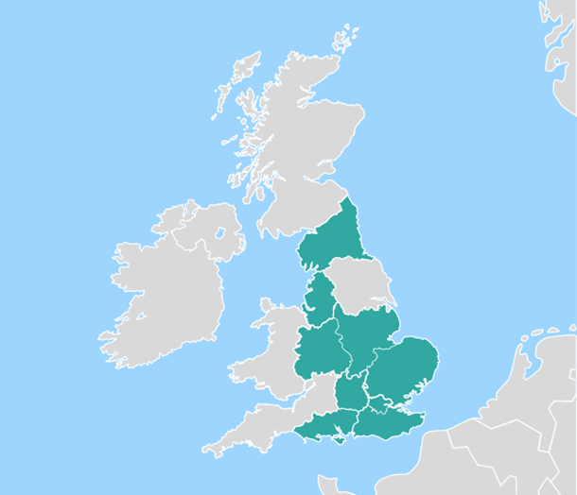
Accent Course Manager
Course booking management system
Used by you and others to book a place on an event run by NHSE Midlands
Application for leave (on Leave Manager) is separate to booking a place on an event (on Course Manager)
Only for events organised by NHSE Midlands
Notes:
Now I’ll give you a brief introduction to Accent Course Manager.
Course Manager is our course booking system; it’s used by learners across the region, as well as consultants, to book places on courses, conferences and meetings run by NHSE East Midlands as well as other regions.
Now it’s currently a separate system, so once you’ve booked onto a course on Course Manager, make sure you submit a leave request for it as well on Leave Manager. Remember, it’s only for events run by NHSE, so you won’t find college courses on there unless we’re running them.

Slide 17
Benefits of Accent Course Manager
Retention of account details – you only register once.
Online evaluation after the event.
Certificates available online.
Better administrative processes – more efficient for staff at NHSE so we use our time better to support you.
One stop-shop for NHSE courses.
Notes:
What’s good about Course Manager?
Well, like Leave Manager, you only need to register once, and it stays with you throughout your training with NHSE. Because it retains your personal details, you don’t need to provide these every time you book onto a course; you just find the event you want to attend and apply for a place.
It includes an online evaluation system, so you can provide feedback on what was good and bad about the event.
Once you’ve completed the evaluation, your certificate gets released to you. And not by email, so you have to find the email again when you want to add it to your portfolio, but it has a section which stores all of your certificates, so you’re available at any time, all in one place.
Finally, it’s a self-contained system; we can quickly add events to Course Manager, and you can find them and book on at any time. You don’t need to email anyone to book your place, and we don’t need to manually email you evaluations or certificates after the event; this means we have more time to support you with queries that actually need a human response!

Slide 18
Need assistance?
If you have difficulties with Course Manager, please let us know!
We’re here to support you - if in doubt, please ask!
Contact your named Administrator in our team
Email the team at FacultySupport.EM@hee.nhs.uk
Any member of our team can advise on general Course Manager queries
Notes:
We have a whole team supporting Course Manager, among other things; if you have any queries, you can contact your named administrator directly (who has probably emailed you about upcoming courses or events), or you can email the team directly at FacultySupport.em@hee.nhs.uk. This is monitored by the whole team, so if your admin contact isn’t available, it can usually be picked up by someone else in the team.

Slide 19
Key takeaways
Leave Manager
Request study leave and/or expenses from your employer.
Address: https://accent.hicom.co.uk/Portal/Live/Web/ Support: StudyLeave.EM@hee.nhs.uk
Online Leave Manager system, no matter your East Midlands training post.
Funding for curriculum requirements, and appropriate aspirational requests.
No individual cap on expenses in Core/Higher clinical training posts.
Include expenses with your leave application.
Course Manager
Book onto a course/activity run by NHSE.
Address: https://accent.hicom.co.uk/ CourseManager/Live/HEE/Web
Support: FacultySupport.EM@hee.nhs.uk
Notes:
So what should you take away from this. [CLICK]
The online Leave Manager system is available at any time, no matter where you’re currently training in the East Midlands or where you’re rotating to next, to apply for study leave. The system will take care of getting approval for you, so you don’t need to email forms or take paper copies around the region to get physical signatures. [Click]
NHSE will support funding for activities that are required parts of your curriculum, as well as for appropriate non-curricular requests. [CLICK]
There is no individual limit on expenses for doctors on substantive training programmes in Core or Higher clinical training posts. Although your TPD and Head of School will review requests to ensure that they are educationally appropriate and cost-effective. [CLICK]
In order to claim those expenses, you must make sure that you include these expenses with your leave application. We encourage you to review our online Study Leave Policy, which has further guidance about how to Add expenses to your leave request, as well as applicable rates and other things to be aware of.

