Slide 1
Pharmacy Technician Led Accident and Emergency Pharmacy Service
By Amy Like
Senior Pharmacy Technician for Accident and Emergency
Wye Valley NHS Trust

Slide 2
Issues of not having a service
Misplaced medications
Medication histories
Prescription errors
Workload
Delayed discharge prescriptions
Compliance
Relationship with Pharmacy

Slide 3
Service offered
A&E based Pharmacy Technician
  During the hours of 9 to 5
  Available to staff via Bleep if not in department
  Working from AMU (Acute medical ward) pharmacy
Currently no capacity for Pharmacist or ATO support for the Accident and Emergency department.

Slide 4
Pharmacy Technician role
Medication histories
Medication related problems
Ordering, supply and delivery of medications
Safe storage of medications
Ward transfer of medications
Counselling patients
Complete discharges
Notes:
Medications histories – ensuring that a safe and accurate history is completed using the most up to date sources

Slide 5
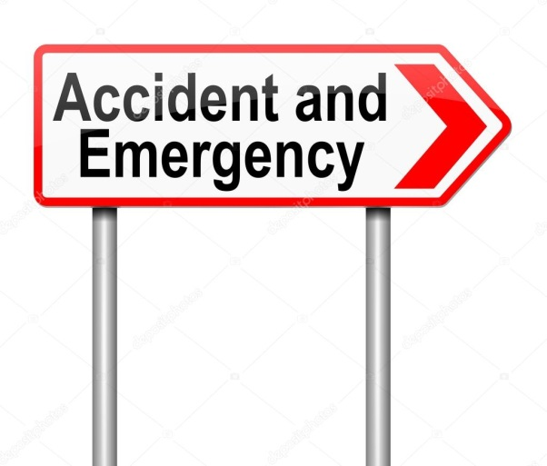
Benefits to A&E
Improve patient flow
Reduction of missed doses
Support for medical and nursing staff
Improved relationship with pharmacy
Medication related problems resolved
Nursing and medical staff time being use more efficiently.
Improved stock list

Slide 6

Benefits to pharmacy
Improved relationship with A&E
Medication histories completed within 24 hours of admission
Decrease in missed doses
Prescription errors identified, reducing administration errors
Reduction of workload in dispensary
Timely discharges

Slide 7
Negative aspects of the service
Service hours are limited
Nature of working environment
No pharmacist/ATO support

Slide 8
Interventions and contributions
Care company duplicating Felodipine dose in error, patient then admitted following a fall
Clonazepam prescribed as 1g Three times a day. Actual dose 1mg Three times a day
Co-carledopa 25/100 (half sinemet) prescribed as ½ a tablet
Fluoxetine prescribed as 125mg Twice a day. Actual dose 20mg Once a day

Slide 9
Savings
Savings from October to February £8,753.09
How savings were achieved :
Encouraging nursing staff to use patients own medications
Asking relatives to bring medications into hospital
Stopping unnecessary supply of medications
Reviewing stock lists
Notes:
Data only collect up until feb 2019
Teaching nursing staff that patients own medication can be used while an inpatient, also encouraging nurses not to send patients medications home with relatives
After carrying out medication histories, ask patients relatives to bring in expensive medication i.e. chemotherapy or if medications are non-formulary getting these brought into hospital (prevents having to find an alternative)
Stopping nursing staff from ordering medication that is on the stock list or if the patient has the medication with them
Amended stock list to allow staff to have more medication available to them 24/7, example Amlodipine and Levothyroxine. A&E shouldn’t need a large stock list due to patient should only be the short term but at WVT some patient have stayed in the department for nearly 24 hours, by allowing certain meds on the stock list this will reduce missed doses or ordering needed.

Slide 10


My feelings about the role
Positive aspects
Learning new skills
Working in a different environment
Improved clinical knowledge
Improving patient care
Job satisfaction
Negative aspects
Feeling isolated
Working environment
Pressure
Negative perception towards pharmacy

Slide 11
Thank you all for listening ☺
Do you have any questions?

