Slide 1
Leadership and Flexible Working
Bob Wheeler

Slide 2
Bob Wheeler
Originally qualified as a barrister
HR Director of Courtaulds Textiles plc
Coaching since late 1980s
Jointly formed Formula 4 Leadership
First coached for TSS in 2009
Coached over 70 Doctors in training for East Midlands PSU

Slide 3
Leadership and Flexible Working
Culture change
“Current incompatibility between medicine, service delivery and society”
“Patients are the primary beneficiaries”
“Empower the junior doctor”
You are the most important people to achieve this!

Slide 4
Why change is necessary
Shortfall of clinical staff
Rota gaps
GPs and nurses leaving faster than they can be replaced
Fewer junior doctors choosing to move straight into specialist training after their first two years’ foundation training

Slide 5
Improving Working Lives
Work life balance
Initiative launched in 2000
Framework agreed in 2009
“Improving others’ working lives seems to be done by making mine worse!”

Slide 6
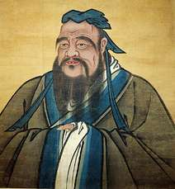
Confucius
The Master said, “At first, my way with men
was to hear their words, and give them credit
for their conduct. Now my way is to hear
their words, and look at their conduct.”
Notes:
Confucius

Slide 7
Improving Junior Doctors’ Lives
“However there is concern about funding implications, maintaining the service and an unintended impact on full time trainees, as well as upon those trainees who need to train LTFT .. There is still a stigma to applying for LTFT training in some specialties, especially when it creates vacancies”.

Slide 8
Value in Diversity
Gender diversity in management positions increases profitability
Culturally and ethnically diverse executive teams were more likely to see better-than-average profits
McKinsey “Delivering Through Diversity” 2018

Slide 9
Secure Base
A person, goal or object that provides a sense of protection, safety and caring and offers a source of inspiration and energy for daring, exploration, risk taking and seeking challenge.
George Kohlrieser - Care To Dare (2012)

Slide 10
Attachment behaviour out of doors
“If they lost sight of her, then all exploration was forgotten. The top priority then became to regain her – in an older child by searching and in a younger by howling”.
J. W. Anderson (1972)

Slide 11
Delegation and Empowerment

Slide 12
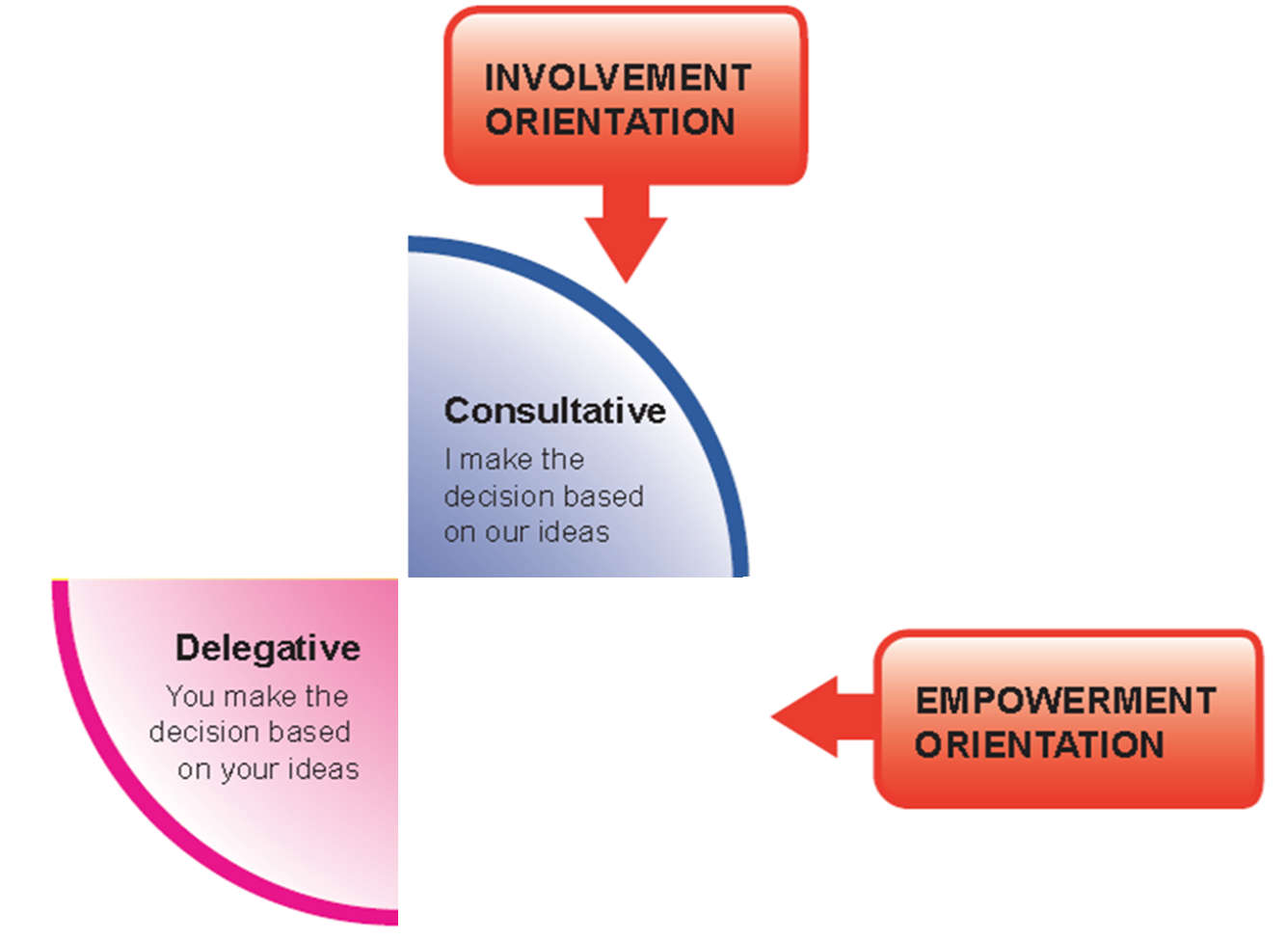
Consultation and Involvement

Slide 13
Leadership and Influencing

Slide 14
Getting the task completed

Slide 15
Formula 4 Leadership
Notes:
Trainer uses tape on floor to bring model to life – inviting delegates to stand in a box and describe their behaviours in a particular situation

Slide 16
… and no more punitive leaders
NHS Response to a dead horse?
Whip it harder
Buy a bigger whip
Visit somewhere else that has a dead horse
Hire an outside contractor to ride it
Lower the standard to include dead horses
Exclude dead horses from performance target
Get a new rider
Re-train the rider
Create a learning set for dead horses
Employ a consultancy to
confirm the death
Stop feeding the horse
(lower running costs)

Slide 17
Contacts
bob.wheeler@wheeler-partnership.com
www.formula4leadership.com
07721 014046
0115 9603425

