Slide 1
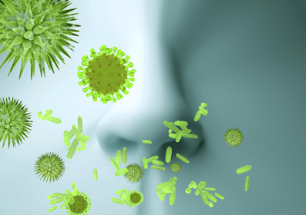
The Benefits of Pharmacy Involvement within Immunology and Allergy Services
Daniel Clarke (Advanced Specialist Pharmacist)
Amie Callow (Pharmacy Technician)
University Hospital of North Midlands

Slide 2
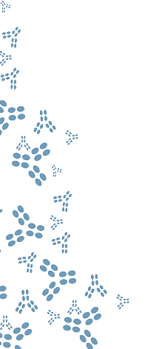

Overview of UHNM Immunology and Allergy Service
UHNM Immunology and Allergy outpatient service commenced in 2010.
Workload has increased by 25% per annum and is still growing.
Currently provides a service for ~135 immunology patients and has reviewed 1000 new allergy patients so far in 18/19 (FYTD).
Immunology | Allergy
Hereditary/Acquired Angioedema Immunodeficiency Immunoglobulin Management | Oro-allergy Desensitisation Allergy Challenges Urticaria Rhinitis

Slide 3
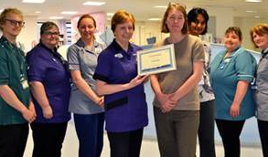
Overview of UHNM Immunology and Allergy Service
Prior to August 2017, service staffing consisted of:
2 x 0.5wte consultants
1 x 1wte immunology and allergy nurse practitioner
1 x 0.25wte allergy nurse practitioner
Band 8a Pharmacist added to service in August 2017 (0.25wte).

Slide 4
IMMUNOLOGY
ALLERGY
Accreditation
Immunoglobulin Governance
Pharmacist Prescriber Urticaria Clinics
Immunoglobulin Procurement
Home Therapy
PHARMACY

Slide 5
Improving Local Immunoglobulin Governance and Procurement
Historic usage of immunoglobulin has increased by 10% year on year
6.8million grams of immunoglobulin was allocated to the UK for 18/19.
However, consumption is predicted to increase by 20% in 18/19 resulting in a potential deficit of ~0.6 million grams.
Increased prevalence of immunodeficiency
International Market
New indications i.e. CAR-T
vCJD vs. UK production
National Shortage
Forecasting Issues

Slide 6
Improving Local Immunoglobulin Governance and Procurement
Achieved Trigger 4 of Medicines Optimisation CQUIN 2017/18.
In March 2018 NHS England request urgent action due to national shortage of IVIG.
Pharmacy produced a multi-disciplinary action plan and executive summary in April 2018.
  Supported by Immunoglobulin Assessment Panel (IAP).
  Completed action plan approved by Trust Executive Committee and Quality Assurance Committee.

Slide 7
Improving Local Immunoglobulin Governance and Procurement
Summary of action plan based upon NHS England and local initiatives:
Clinical | Operational | Pharmacy | Governance
Review SAgD patients | Monthly IAP meetings | Review procurement data monthly | Update risk registers
Consider PLEX | Pathway for grey indications | Produce guidance on brand selection | Ratification by Trust Executive Committee
Ensure 1g/kg dosing for ITP | Escalation pathway for non-compliance | Manage withdrawal of Kiovig® | Produce patient communication
Consider trial of steroids in CIDP | Optimise sc usage
Review long-term autoimmune neuropathies | Validate CMU data
Produce guidance on the use in sepsis

Slide 8
Improving Local Immunoglobulin Governance and Procurement
Compared to 17/18 UHNM demonstrated a reduction in immunoglobulin usage:
- Reduced overall usage by 12%
- Reduced IV usage by 20% in 18/19
Compared with an anticipated growth of 10% in 18/19, this represents ~20% reduction in overall usage.
- Approximately £500,000 saving per annum for NHS England specialised commissioning services.

Slide 9
Improving Local Immunoglobulin Governance and Procurement
Immunoglobulin framework introduced in June 2016.
Pharmacy procurement processes include:
- CMU tender validations.
- Relationship with pharma companies.
- Monthly review of usage, allocation and stock.
- Release monthly block orders.

Slide 10
Improving Regional Immunoglobulin Management
NHS England requested the formation of Sub-Regional Immunoglobulin Assessment Panels (SRIAP) in September 2018.
Pharmacy fundamental in developing the infrastructure for the SRIAP:
- Terms of Reference.
- Request documentation.
- Request process and compliance with data protection regulations.

Slide 11
Pharmacy Technician Role in Immunoglobulin Management
Pharmacy technician fulfilling the role of SRIAP co-ordinator.
Responsibilities include:
- MDSAS database management
- Facilitate ‘Request/Approval’ process
- Provide structure to SRIAP patient reviews
- Assist with audit and procurement processes

Slide 12
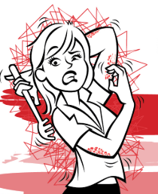
Pharmacist Urticaria & Angioedema Clinic
1 pa per week starting April 2019
Reviewing new and existing patients
Generates ~£20,000 per annum
Benefits of a pharmacist prescriber
  Skin prick testing
  Complex allergy
  Drug handling in Pregnancy
  Low dose ciclosporin
  Commissioning

Slide 13
Home Therapy
Provide home therapy services for:
SC and IV immunoglobulin:
- Ancillary bundle charges introduced Oct 2017.
- Repatriated patients from HEFT Nov 2017.
- Cap on patient numbers increased to 14 per annum in July 2018.
- Attend patient coffee mornings.
Cinryze® and Firazyr®:
- Monitor patient usage and escalate usage in excess of commissioning agreements.

Slide 14
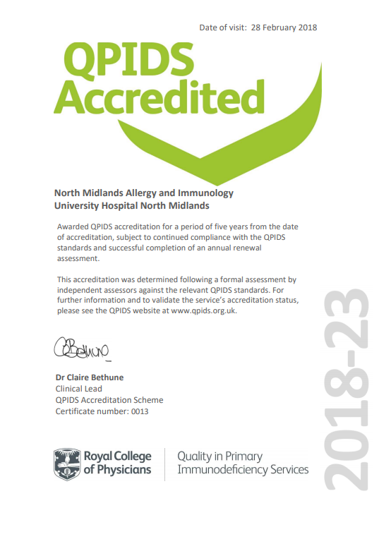
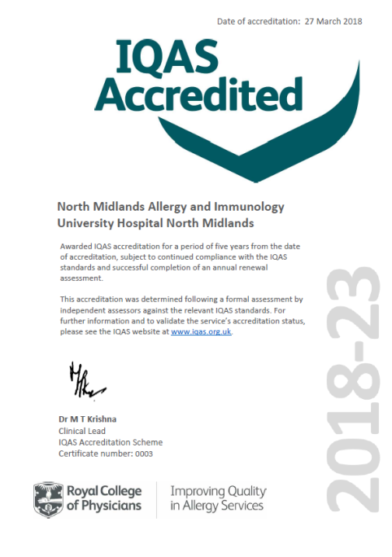

Allergy and Immunology Accreditation
Pharmacist supported accreditation processes:
- Attend monthly accreditation meetings.
- Dilution protocol validation.
- Support development of documents and patient information.
- Interviewed as part of accreditation process.

Slide 15
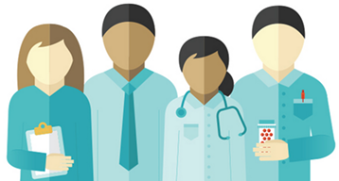
Pharmacy Value to the Clinical Team
‘Identification and prioritisation of HAE treatment outliers’
‘Essential role to the SRIAP infrastructure and operations’
‘Reviewing departmental protocols and patient information from a good prescribing practice’
‘Treatment planning and resource allocation – i.e. oral desensitisation’
‘Contributing to quality improvement’
‘Assisting with accreditation’
‘Crucial role for a single point of contact for CMU and Ig suppliers to manage stock efficiently and fairly’
‘Robust oversight of high cost drugs including omalizumab, immunoglobulin, C1-esterase…’

Slide 16
Next Steps…
Assess the impact of SRIAP
Identify quality and service benefits of Pharmacist prescriber delivered urticaria clinics
Review of C-1 usage and improve risk-sharing with recombinant therapies
Review oral desensitisation provision arrangements

Slide 17

Questions?

