Slide 1


Enhance Foundation Programme Induction (East Midlands)

Slide 2

Topics to be covered
Enhance overview
PGVLE
Time commitments and expectations
Enhance explore placements
Let’s start with a short video

Slide 3

The goal of Enhance
Notes:
Lets start with a short video
Complex co-morbidity
Health system, working collaboratively across NHS
Holistic care rather than disease focused
Environmental health, sustainable healthcare
Social agendas, health equity

Slide 4


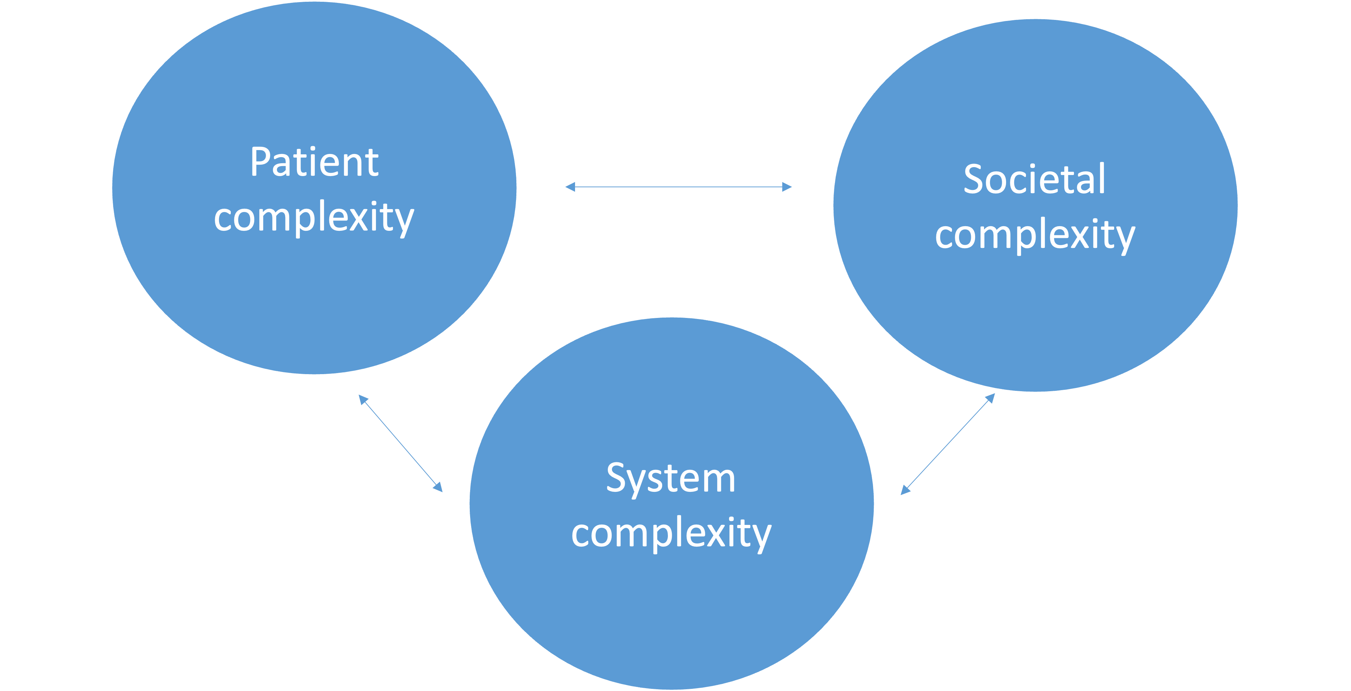

What is the enhance programme?
enhance

Slide 5
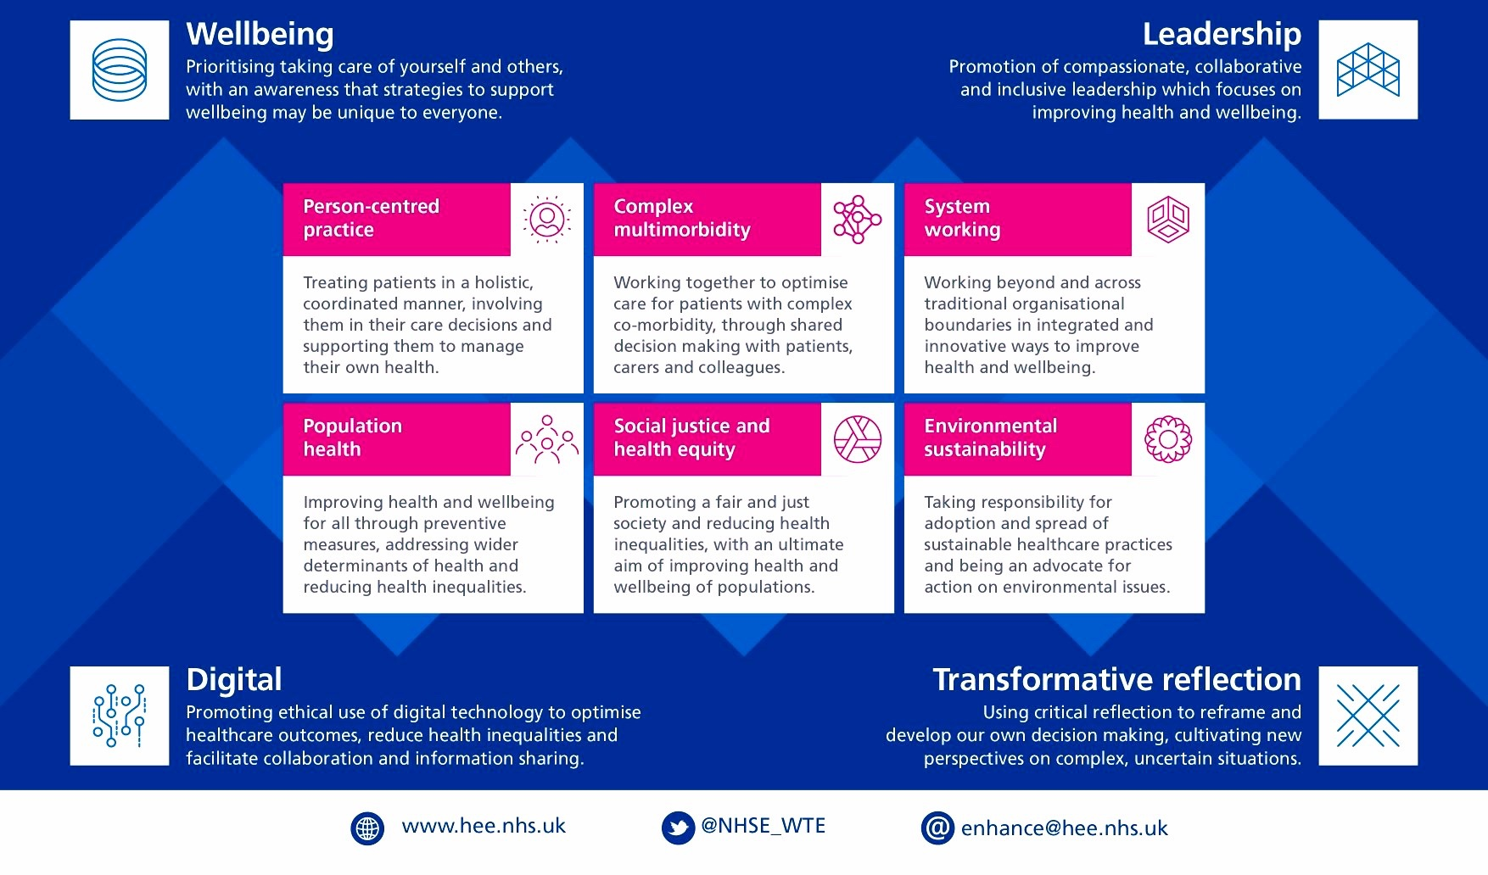

Slide 6
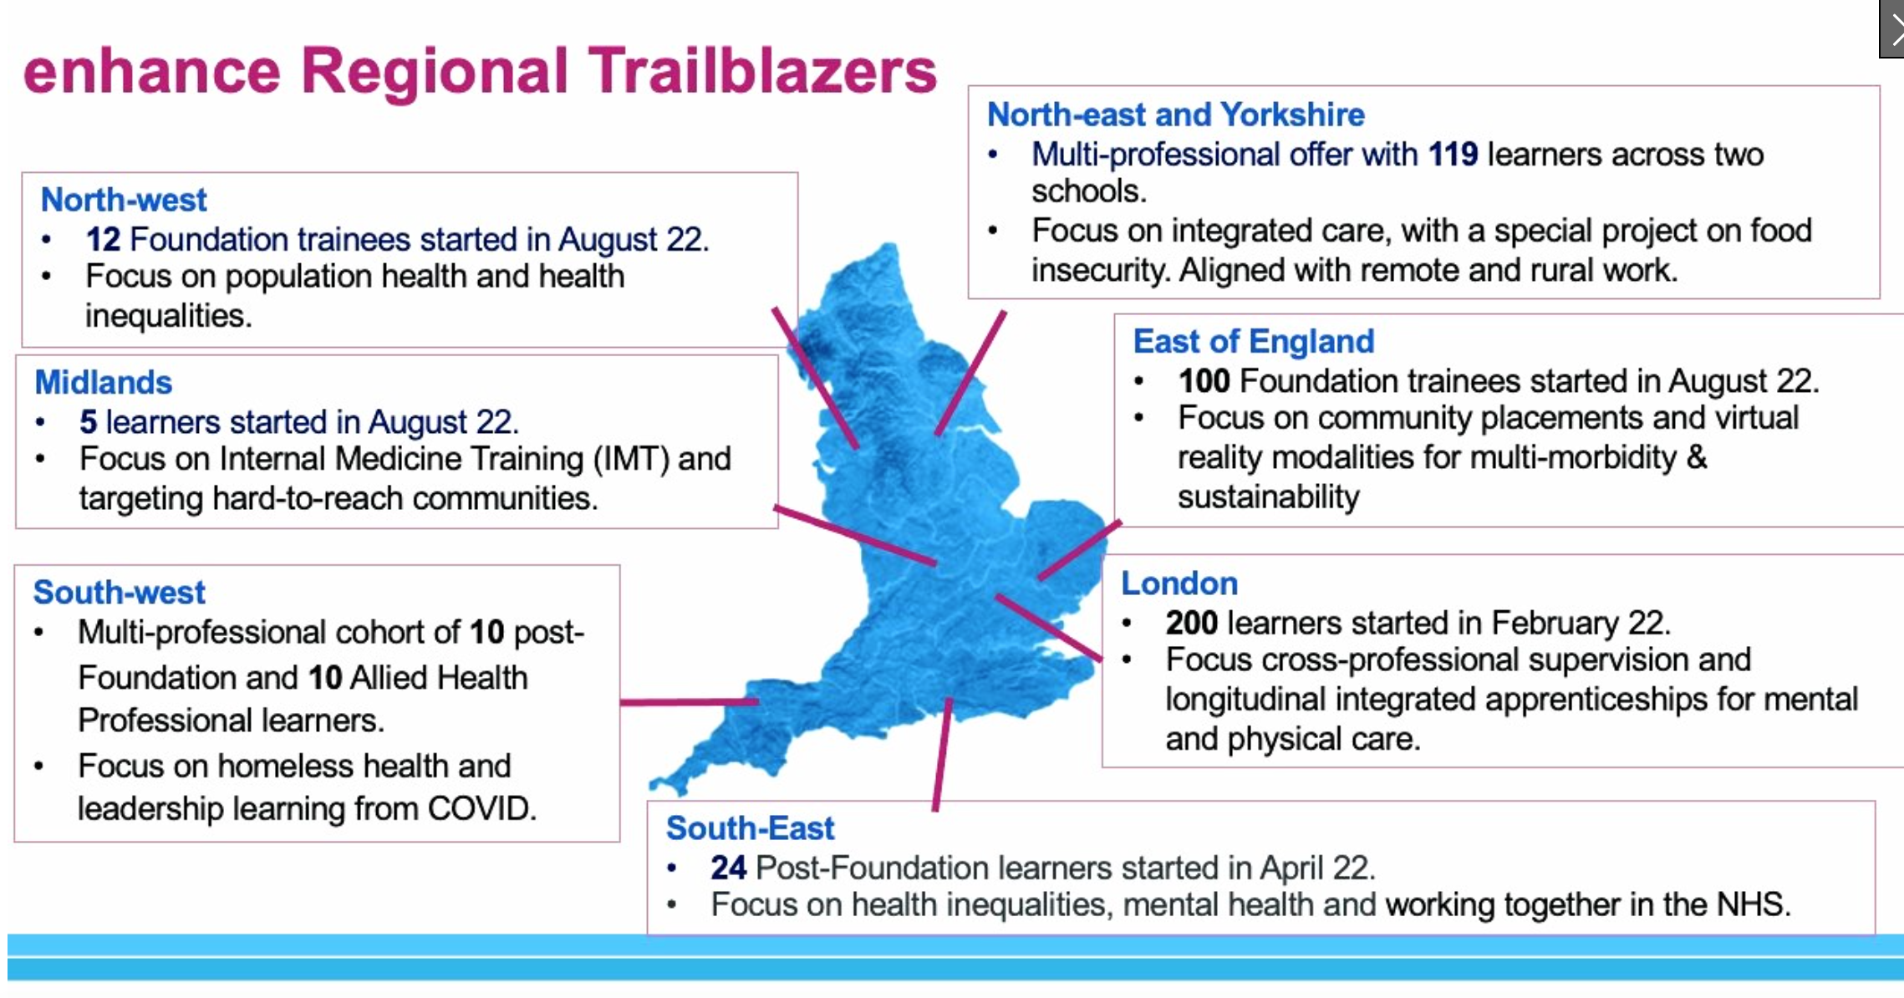

Slide 7
Enhance for Foundation
Enhance enable – [theory]
Available to all foundation doctors in England
Self-directed learning with online module workbooks, reflective practice and engagement with online resources
Enhance explore – [theory and application]
Opportunity to apply this learning into practice
Bespoke community placements in F2
Pilot scheme August 2024-2025
Plan to offer these on Oriel as Priority programmes
Notes:
GUM clinic, public health and GP

Slide 8
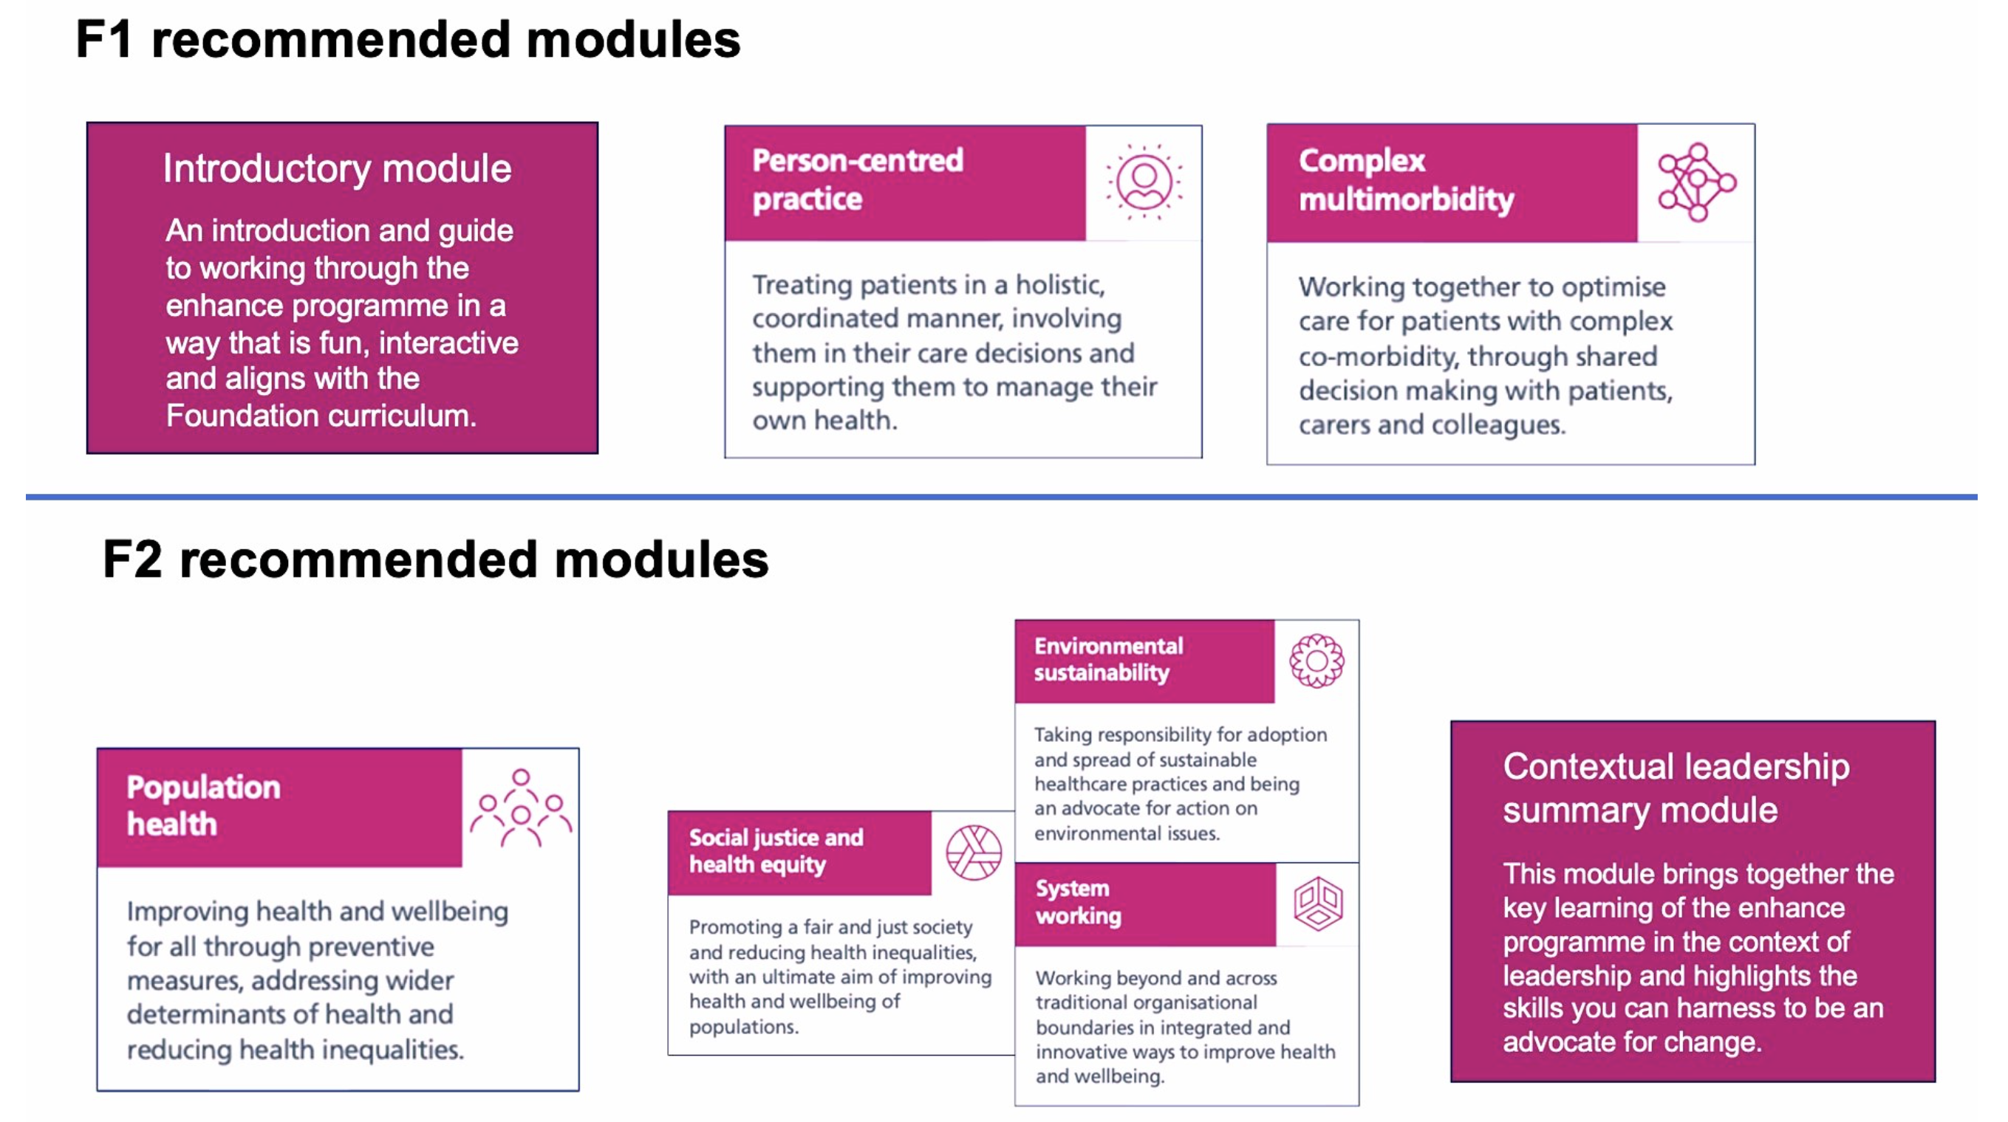
Enhance Enable - PGVLE
Takes approx 4hrs learning per module

Slide 9

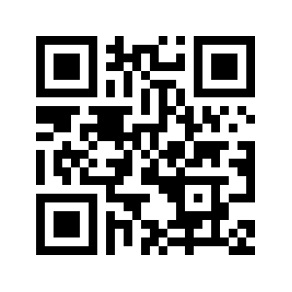
How can I get started?
USERNAME = GMC NUMBER

Slide 10
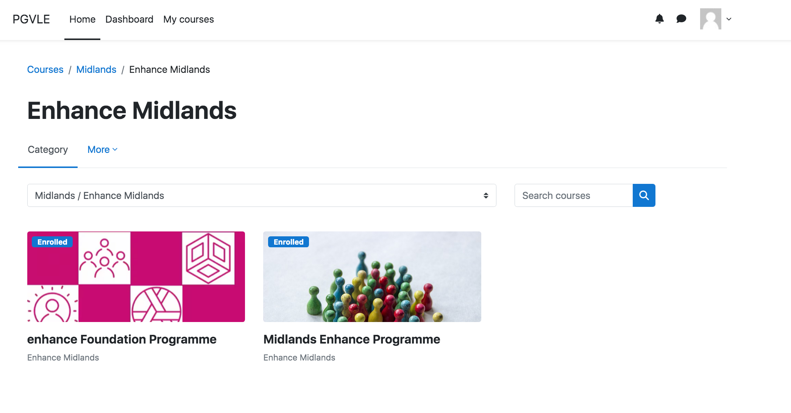
Enhance Enable - PGVLE

Slide 11
Self-directed learning: enhance enable
Take responsibility for your own learning
Use resources available in a way that suits you best and meet your learning needs
  Eg a speciality specific focus or based on your previous knowledge/experience
Not a limited resource bank
Reflect on the process

Slide 12
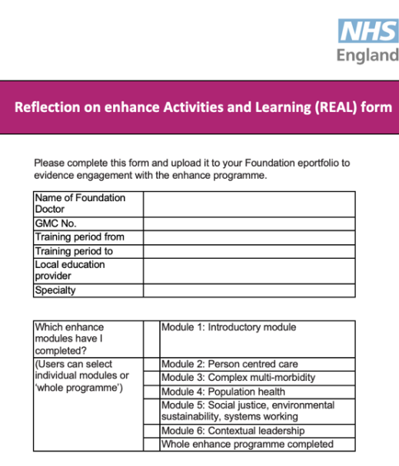

Evidencing participation
REAL form on Horus (Reflection on enhance activities and learning)
Feedback forms on PGVLE

Slide 13

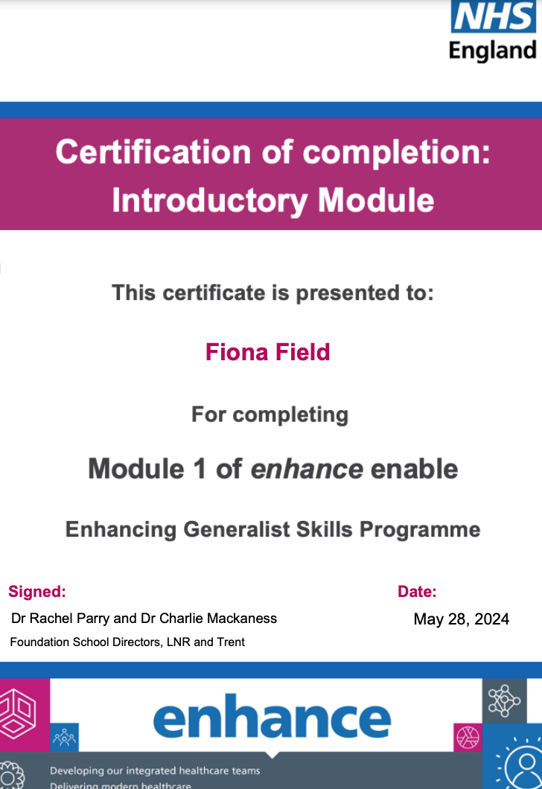
Enhance enable - Certificates

Slide 14
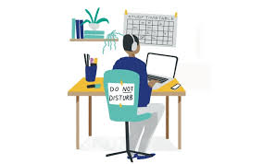
Study Leave
Claim back *3 days in study leave after completing all the online modules.
*3 days spread across F1 and F2, 1.5 days each year

Slide 15
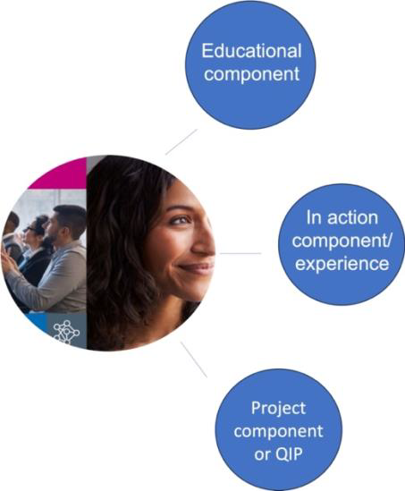
Enhance Explore
Bespoke community placement of F2
Outreach work, vulnerable communities, complex comorbidity and frailty
Protected time for Enhance opportunities
Pilot 2024-2025

Slide 16
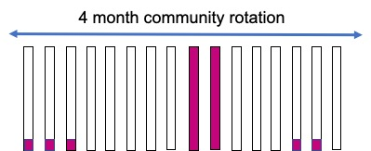
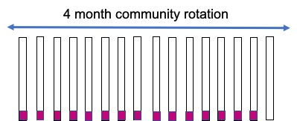
Enhance Explore
OR
F2 Enhance trainee will be released for 15 days of their community placement (GP, sexual health etc)
10 days for immersive project placement or outreach work and 5 days to complete enhance enable/attend local live enhance teaching.
10 days will either be as a two-week block or as one day per week as explained above.
F2 encouraged to complete audit/QIP relating to Enhance for completion of Enhance Foundation Programme

Slide 17
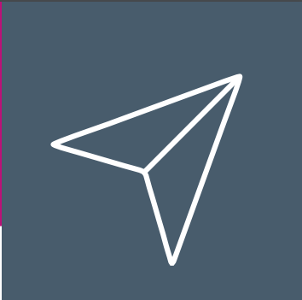
Enhance Explore
Enhance-integrated posts
  Enhance domains are naturally part of the placement and integrated into normal work pattern
    Sexual Health (KMH, RDH, NUH)
    Public Health (Sherwood and Lincoln)
    GP- Frailty (Lakeside Corby)
Notes:
Approximately 5 posts lined up for august 2024 pilot

Slide 18

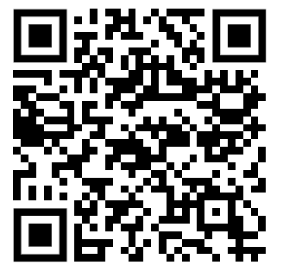
Health inequalities
Maternity continuity of care = 7% at NGH
The aim was 75% by end of 2023
38% people with a LD received an annual health check in 2021.
The aim is 75%.
Notes:
How to undertake a health equity audit
Tools and templates

Slide 19
Project component/QIP
Enhance Contextual Leadership Certificate
Completion of all three elements
East Midlands Enhance Presentation Day for project component – 1st July 2025

Slide 20
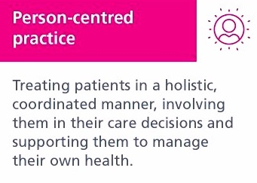

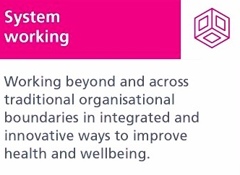




Enhance and the Foundation curriculum

Slide 21
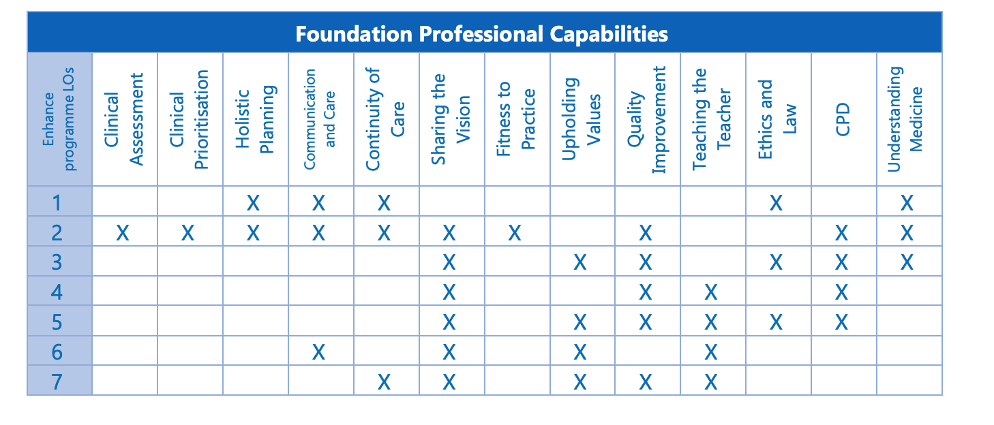
Enhance and the Foundation curriculum

Slide 22


Slide 23

Questions?

