Slide 1

Prescribing Pharmacist in Frailty
Kim Selby- Lead pharmacist for Frailty

Slide 2
Overview
Introduction
Objectives of the PDSA
How we did it
Outcomes
Plans for the future

Slide 3
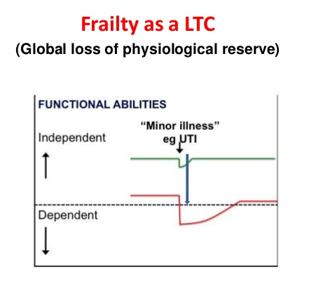
What is frailty?
A reduced ability to withstand illness without loss of function.
A minor event can trigger major changes in health from which the patient may fail to return to their previous level of health.

Slide 4
Frailty Syndromes
Falls (e.g. collapse, legs gave way, ‘found lying on floor’).
Immobility (e.g. sudden change in mobility, ‘gone off legs’ ‘stuck in toilet’).
Delirium (e.g. acute confusion, sudden worsening of confusion in someone with previous dementia or known memory loss).
Incontinence
Susceptibility to side effects of medication (e.g. confusion with codeine, hypotension with antidepressants).

Slide 5
Frailty in the hospital setting
Older people with frailty account for:
  5-10% of people attending ED
  30% of patients in acute medical units
These patients are especially vulnerable to:
  Delays in hospital
  Deconditioning- bedrest and inactivity (adding to the presenting problem)
Notes:
Delays and deconditioning- Failure to identify a delerium. The delerium leads to poor oral intake and reduced mobility and can result in dehydration and pressure sores which add to the primary presenting problem.

Slide 6
Acute Frailty Service Provision
NHS improvement expects all type 1 ED Trusts to provide an acute frailty service for at least 70 hours per week by 31 December 2019
Patients should have input from the wider MDT:
  Physiotherapists
  Occupational therapists
  Pharmacists
  Case managers

Slide 7
Frailty PDSA
SWFT decided to trial opening a Frailty Assessment Unit (FAU) for a period of 2 weeks in June 2018.
Patients referred from GPs or directly from A&E
Reviewed by the whole MDT in the assessment area- ACPs, consultant, physiotherapists, occupational therapists and pharmacists

Slide 8
Frailty PDSA
For the 2 week PDSA the frailty assessment unit was covered by a prescribing pharmacist
Objectives were:
  Complete level 2 medicines reconciliation at the point of admission to the FAU (much earlier on in the patient journey)
  Accurately prescribe current/new medications if necessary
  Complete medication reviews using the STOPP START criteria
  Falls reviews and bone protection
  Facilitate discharges and communication of medication changes with primary care

Slide 9
Number of patients reviewed
67
Patients on FAU
60%
Seen by a pharmacist
40%
Not seen by a pharmacist
12%
After 5pm
9%
Day of no pharmacist cover
1.5%
Clinic attender
1.5%
Seen in ADU
16%
Not seen due to time constraints

Slide 10
Level of medicines reconciliation

Slide 11
Medication reviews
40
Patients seen by a pharmacist
88% 35/40
Received medication reviews
78% 31/40
Received falls Reviews
85% 34/40
Changes/interventions made
56% 19/34
Changes to Drug History
47% 9/19
Primary medication changes
53% 10 /19
Secondary admission prevention medication changes
44% 15/34
Interventions to prescription chart
Out of the 34 changes to medication made 41% were involving critical medication

Slide 12
Successes
Reduced length of stay for patients >75 years
Improved patient flow through the hospital
Patients seen by frailty team much earlier on in admission
Earlier medicines reconciliation
STOPP START medication reviews to prevent future admissions
Bone health
Improved communication with primary care regarding medication changes
Training of the wider MDT regarding medication issues

Slide 13
Limitations of the PDSA
Pharmacists not able to see all patients due to hours of work- available 8.30-5pm
Pharmacist cover on 9 out of 10 days of the PDSA
Pharmacists also providing cover to AMU so could not be present on FAU all day
Pharmacist not always informed of patients in a timely manner- 11 patients not seen

Slide 14
Outcome of the PDSA
5 day ACP led frailty service now operating 8am-8pm
Direct referrals from A&E/ ACPs actively highlighting suitable patients
Direct referrals from GPs and paramedics
Full time Band 8a prescribing pharmacist for Frailty funded by the Trust working 8.30-5pm 5 days a week
Funded to complete the advanced health assessment module

Slide 15
Now and in the future
Assisting with clerking of patients
Teaching- junior doctors, nurses, medical students
Based on the frailty assessment unit
Joins frailty ward round on AMU
Future- further progression down ACP pathway?

Slide 16
Questions?

