Slide 1
Introduction of Automated Compliance Aid Dispensing Robot
Laura Nicholls
Jeanette Dudley

Slide 2
Introduction
Background
Why use a compliance aid in mental health services?
BSMHFT trays processed by hand.
3-4 staff members working on these every day.
Greater risk of staff RSI.
Visited suppliers of machines that produced compliance aids.

Slide 3
Implementation
2016-2017
Testing
2017-2018
Staff Training
Roll out plan
2018-2019
Modifications
Error reporting system developed.

Slide 4
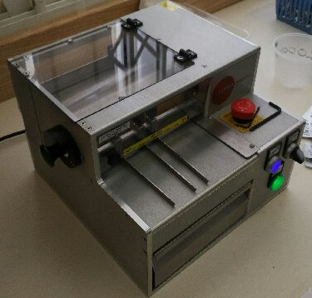
De-blistering medicines and Filling the Robot
De-blistering machine

Slide 5
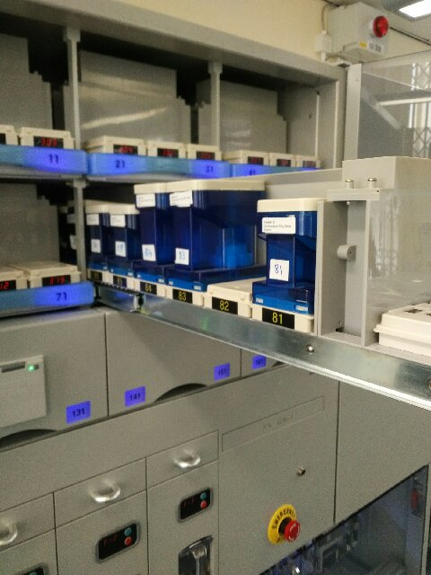
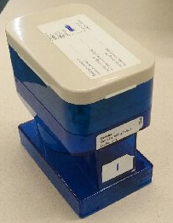
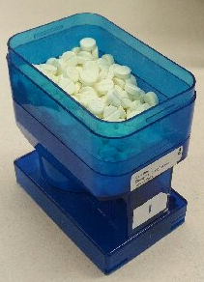
De-blistering medicines and Filling the Robot
Canisters

Slide 6
Impact of the Robot at BSMHFT
Time.
Improved accuracy.
Fewer staff working on compliance aids.
Not using robot to full capacity.

Slide 7
Robot

Slide 8
Robot – Top Section

Slide 9
Robot – Middle section

Slide 10
Robot – Bottom section

Slide 11
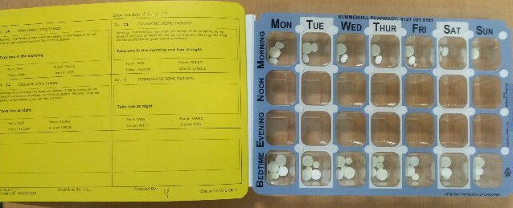
The finished Product

Slide 12
Contact Details
laura.nicholls@nhs.net
jeanette.dudley1@nhs.net
0121 301 5160
Any Questions?
Thank you for listening.

