Slide 1

Study Leave induction
Dentistry
Presented by:
Karolina Wlodowska

Slide 2

NHS England
Merged organisation
NHS England
NHS Improvement
NHS Digital
Health Education England (HEE)
“East Midlands Deanery”/
“The Deanery”
Notes:
There’s a few terms that you’ll hear and see to refer to our organisation, so I’m going to quickly cover them. Over 2022-23, NHS England merged with other NHS organisations, with Health Education England, or HEE, joining on 1 April 2023. You may notice that our contact emails still have HEE in them – we will be moving over to NHS.net addresses later this year, but we’ll communicate to everyone about that when we know more.
You may also notice our website says East Midlands Deanery or have heard people refer to “the Deanery”. This was the organisation that supported study leave in this region until 2013, at which point it became part of Health Education England, which is now part of NHS England.
So, all these terms refer to us, but the current name for our organisation is NHS England, and that’s the name we’ll be using in this induction.

Slide 3
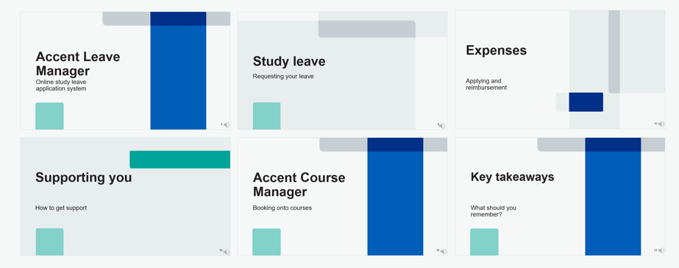
This induction
Notes:
In this induction, we’ll cover an overview of Accent Leave Manager, how to request study leave, how to get your expenses reimbursed, how to get help, and Accent Course Manager.

Slide 4
Accent Leave Manager
Online study leave application system

Slide 5
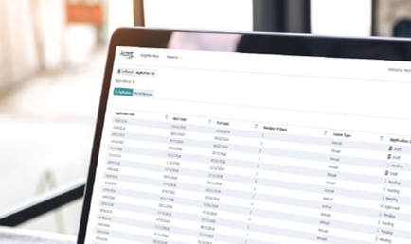
What is Accent Leave Manager?
Online study leave application system
https://accent.hicom.co.uk/portal/live/web/
If you’re on a formal NHS England training programme, you have access
  Use ‘Forgotten Password’ on the homepage to set up your login.
Applicable to everyone on East Midlands training programmes.
  Rolling out nationally.
Pro-rata entitlements Sep-Sep.
Approved lists of events, courses, exams.
Notes:
[CLICK] In the East Midlands we use an online application system called Accent Leave Manager. The advantages of using an online system is that everything’s set up for you; your rota coordinators and TPDs are set up as approvers for all your posts no matter where you are in the region, and can approve your leave by simply logging into their own accounts. [CLICK]
Everyone on a formal NHS England training programme in the East Midlands is automatically given access. If you missed the activation email, or you were previously on an East Midlands training programme and have forgotten your password, use the Forgotten Password link on the homepage. Your email address will be the one you have registered with NHS England for your training, which will be the same one you use for TIS Self-Service. [CLICK]
The Leave Manager system is used by all of you across East Midlands programmes, and in all hospitals, so you should have the same experience no matter where you rotate. The same system is now also being rolled out across the country, meaning all NHS England local offices will soon be using Accent Leave Manager for study leave management. [CLICK]
The study leave year runs in line with the standard training year of September to September. This means that if you start or finish training part-way through the year, go Out of Programme, or work less than full-time, you receive a pro-rata entitlement of study leave days, just like with annual leave. [CLICK]
There’s also a list of activities built into the system that have been agreed by your TPDs; I’ll cover this in more detail later. [CLICK]

Slide 6
Study leave
Requesting your leave

Slide 7
Entitlements
Curricular
Discretionary
Your entitlement
Activities explicitly mandated in the curriculum e.g., exams
Any activities not on the pre-approved list of activities.
Private leave (exam revision time).
Includes Curricular Support activities.
Some suggested extra-curricular activities.
Leave Manager keeps a running total and only allows applications up to the remaining entitlement
Adjusted pro-rata if you start/leave/complete training part way through the year, or go out of programme (OOP)
Notes:
Leave Manager works on the concept of entitlements. These are split into curriculum required and discretionary days; [CLICK]
Curriculum required activities are usually activities run by either your School, or by NHS England, which this will include locally delivered teaching such as weekly afternoon teaching, monthly regional teaching, and any protected teaching time within job plans. The entitlement also includes exams which are required for the curriculum[CLICK]
Discretionary leave covers everything else; any activities not on the pre-approved, curriculum requirement list, [CLICK]
as well as private leave for exam revision. [CLICK] It also includes what we call Curricular Support activities which support Curricular competences but are not themselves required – such as certain exam revision courses, or courses that develop skills required for your curriculum but which you could also achieve in normal training. [CLICK]
You can check your entitlements at any time by going to the My Entitlements section of your account. [CLICK] Leave Manager will only allow you to submit leave applications up to your remaining entitlement, so it’s important to plan what you need study leave for early in the year. [CLICK]
Study leave days are pro-rata; if you train less than full time, start or finish training part-way through the year, or go out of programme for any reason, this will affect your entitlement for that year. Your entitlements to study leave are set by your TPDs annually, but there is flexibility, with the approval of your TPD, to amend your split of curriculum required vs discretionary days – if you feel that your split doesn’t reflect your needs for the year, please discuss this with your TPD.

Slide 8
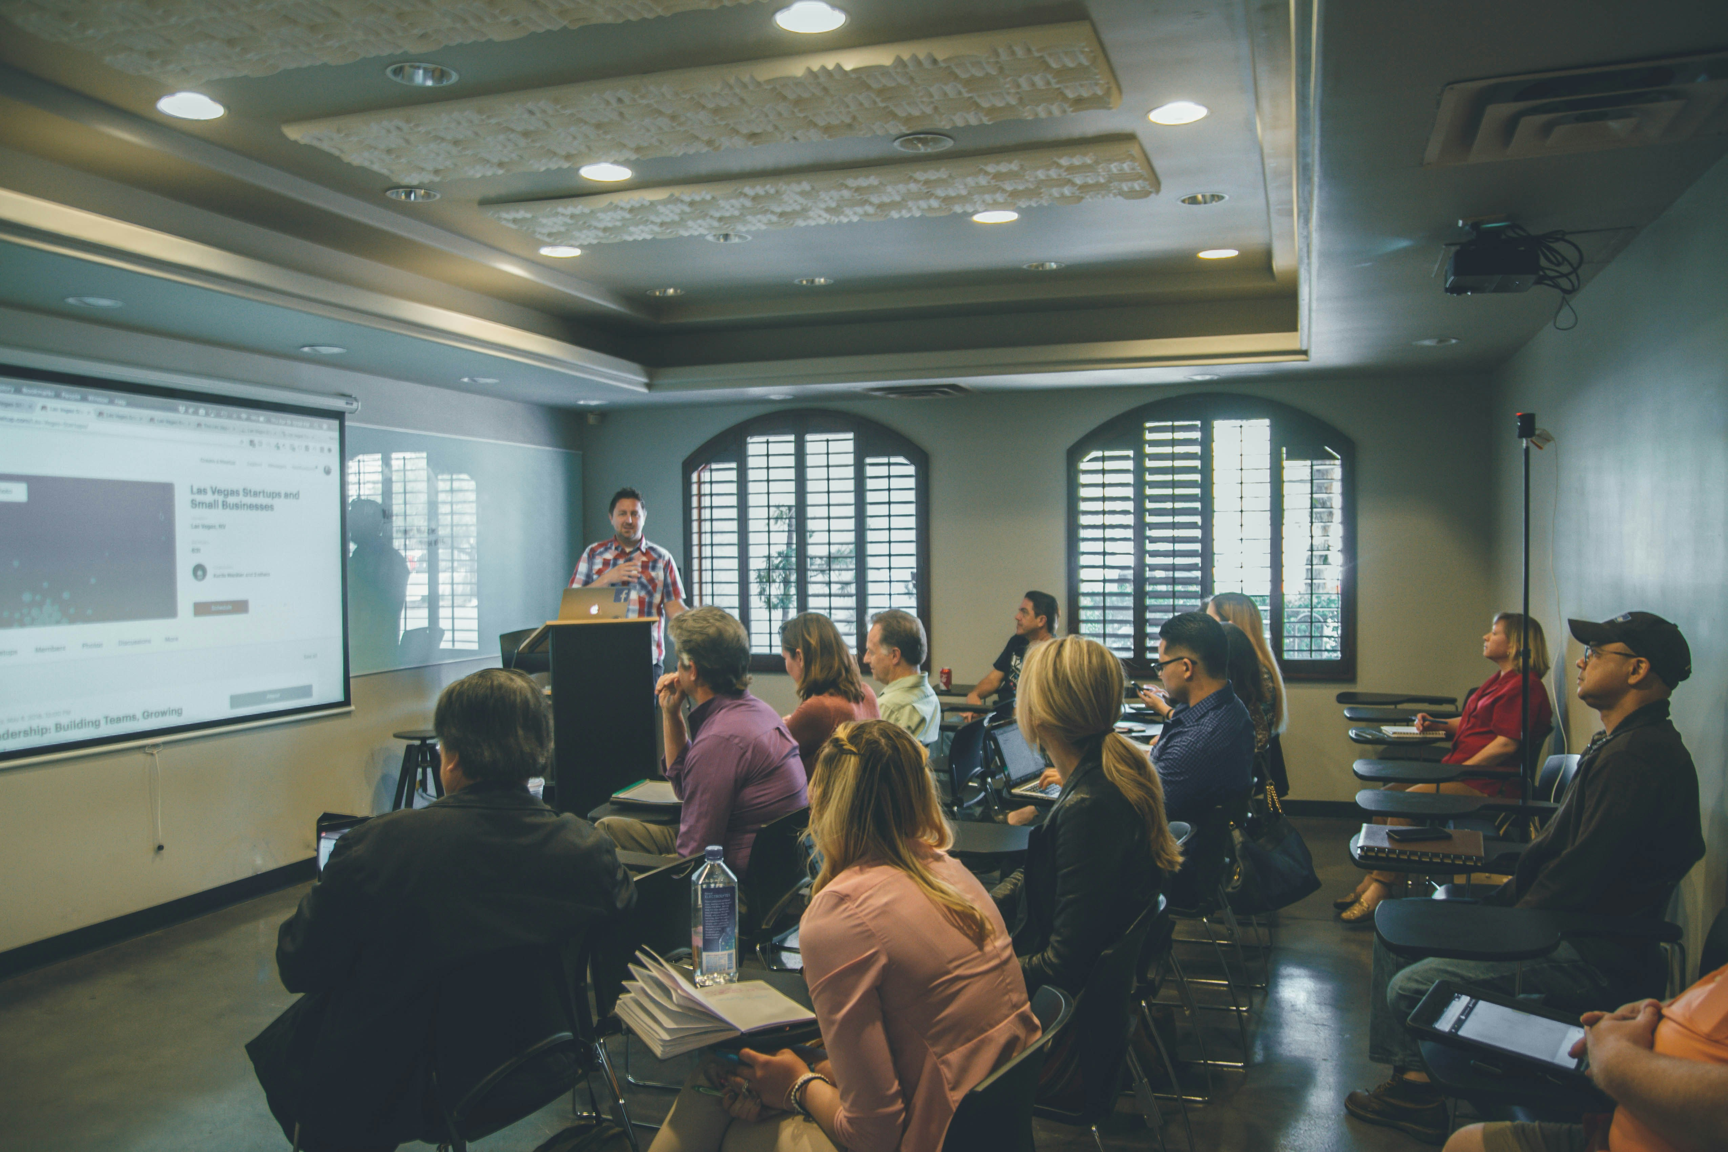
List of activities
Required and suggested activities for your programme
Schools confirm which events are applicable to you and whether they are ‘curriculum required’ or ‘curricular support’.
Approval of time off by rota coordinator/local equivalent
When you apply, Accent Leave Manager does all the calculating.
Can also submit requests for discretionary activities.
Approval of suitability by TPD.
Notes:
NHS England is committed to supporting you with study leave time and expenses for activities that directly support your curriculum requirements. [CLICK]
As I mentioned before, your TPDs have provided a list of activities which are requirements for your curriculum, which can include courses, and exams. [CLICK] These can be applied for with only approval from your rota coordinator, JDA, or local equivalent. [CLICK]
When you apply for an activity, Leave Manager does all the calculating for you, so you don’t need to remember which courses are curriculum required or discretionary. [CLICK]
Your TPDs have also included some suggested activities that support you demonstrating curriculum-required competences, but which could be achieved in other ways (known as curricular support activities). Both curriculum activities and curricular support activities can be seen in the drop-down list on Leave Manager when you apply.
Discretionary activities can be applied for by checking the box that indicates the event is not on the approved list and either select the appropriate activity from the new drop-down menu, or manually type in the name of the activity that you wish to attend. [CLICK]
For curricular or curricular support activities, only the approval from your rota approver is required. For discretionary activities, your TPD will also be included in the approval chain.
A full list of the activities can be found on our website.

Slide 9
Submitting a leave request
ACTION KEY
= Applicant
action
= Trust
action
Applicant submits study leave request (including estimated expenses) on Leave Manager
Request
directed by system based on post no.
Rota Approver
= Educator
action
= System
action
Rejected
Approved
Programme Director
On Curriculum
Requirement/ Support list?
No
Yes
Reviewer must provide comments with reason for rejection.
System emails Applicant to confirm rejection of study leave.
System emails
Applicant to confirm approval of study leave
Approved
Notes:
Let’s walk through the leave approval process in Leave Manager
1. You submit your leave request on Leave Manager, including an estimate for your expenses, if there are any. These estimated expenses don’t be precise but should cover what you expect to spend.
2. This request is automatically directed to the appropriate rota coordinator based on your post number.
You can also see who has approved your request, and whose approval is still pending, on your leave request at any time by opening the request in the My Applications section of your account and scrolling down to the Approval Chain section.
3. The rota coordinator will receive an email notification of your request.
4. If the rota coordinator rejects the request for any reason, then Leave Manager will email you to confirm this, along with the reason given by the approver.
5. Assuming that everything is fine with the leave request and the rota coordinator authorises the request, then it progresses to the next stage.
6. If you have applied for a Curriculum Required or Curricular Support activity, then that’s it – Leave Manager will email you, and the approvers for reference, to confirm that the request has been approved. If you have applied for a Discretionary activity or an International activity, then the application will progress to the TPD. Again, if the application is approved or rejected, you will receive an email notification from the system.
Leave Manager doesn’t offer the option for you to just change your request after it’s submitted; this is to help prevent confusion over rotas and spending. You can submit a cancellation for your leave request, but this isn’t always necessary. As we suggest on our website, if it’s just that you need to add or amend your expenses or the number of days, you can contact our team and we’ll update your application for you. However, if there is a change in dates or the activity details, a new application needs to be submitted as these details cannot be changed once the application is submitted.

Slide 10
Approval sequences
Curricular or Curricular support activities
Rota Approver
Discretionary activities
Rota Approver
TPD
International activity
TPD
Associate Postgraduate Dean
Rota Approver
Notes:
Here is a summary of the approval chains you can expect to see on Leave Manager, depending on the application you submit.
Apart from the ones we have already discussed, for international leave, you will see that approval from the Associate Postgraduate Dean is required.

Slide 11
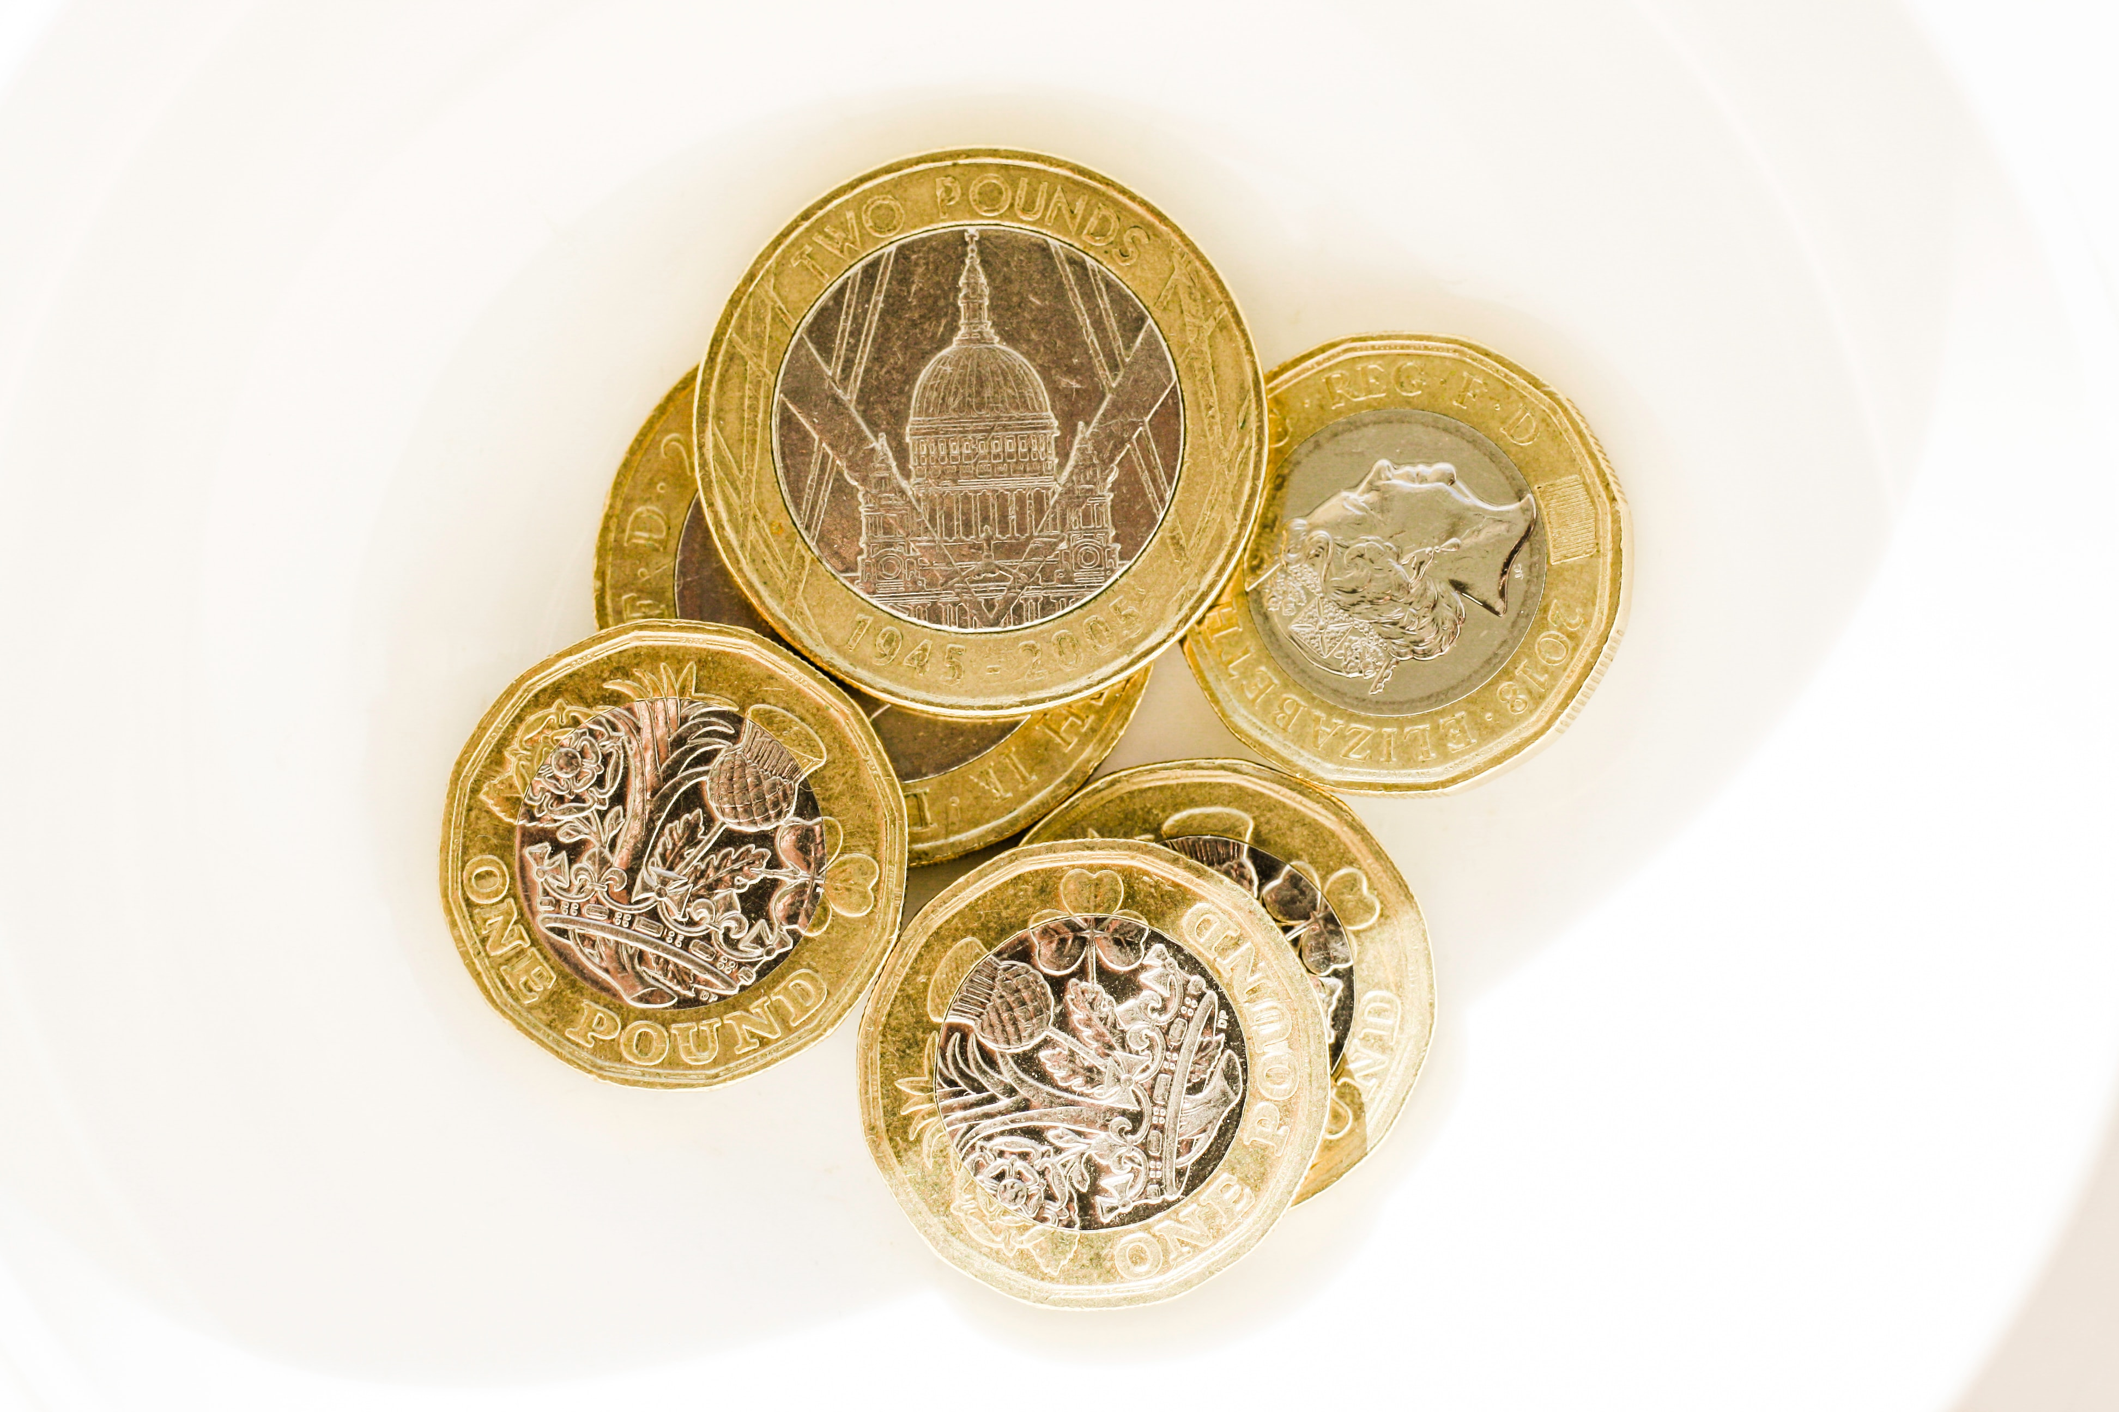
Budget increase request
How to request a budget increase
Needs to be requested before applying on Leave Manager
All requests need to be submitted via online form: www.eastmidlandsdeanery.nhs.uk/policies/Study_Leave/Mainpage
Notes:
If you feel that your budget is not sufficient for the training year for any essential activities, you can apply for a budget increase.
The request form can be found on our website under Dental guidance. Once you submit the request is it then reviewed by the School to ensure the educational appropriateness and value for money. If you request is approved, you will receive an email notification for this and your budget will be updated on Leave Manager.

Slide 12




Leave types
‘International’ leave
For all international study leave requests.
‘Private’ leave
For private exam revision, in the run-up to an exam.
‘Exam’ leave
For attending exams.
“Study” leave
For everything else.
Notes:
There are four different types of leave that you can apply for on Accent:
“International” is for all international study leave requests.
“Private” leave is for private exam revision, in the run-up to an exam. You can apply for a maximum of 5 Private leave days a year, and this comes out of your Discretionary entitlement. You cannot apply for expenses during Private leave, as this is for revision time only. If you are applying for an exam revision course for which you want to claim expenses, you need to use the leave type ‘Study’.
“Exam” leave is for attending exams, and always comes out of your Curriculum requirement entitlement for exams which are required for your curriculum. For exams not required for the curriculum, these will come from your Discretionary entitlement.
“Study” leave is for everything else.

Slide 13
Expenses
Applying and reimbursement

Slide 14

Study leave funding
Funding is available for:
  Curriculum-Required (explicit curriculum requirements)
  Curricular support (support the achievement of curriculum competences, but not necessary to attain those competencies)
  Discretionary (non-curricular activities)
Budget set per programme £600 – pro-rata
Continue to apply for reimbursement via employing Trust
Apply on Leave Manager as a leave request (https://accent.hicom.co.uk/Portal/Live/Web/)
Notes:
[CLICK] So as mentioned, NHS England will support the appropriate costs for your curriculum-required activities, including the course fees and any applicable travel, accommodation or food in line with NHS Terms & Conditions of Service rates. But there is also funding available for [CLICK] Curricular support activities, which are activities that may support you achieving curriculum required competences, but aren’t required courses themselves, and [CLICK] Discretionary activities, which are activities that don’t directly relate to your curriculum, but support your overall development as a doctor, such as specialist interests, as long as you’re achieving your curriculum requirements. [CLICK]
For Dentistry, the current budget is set at £600 for the academic year, calculated pro-rata based on your whole time equivalent (WTE). This cannot be transferred to the next academic year.
You continue to apply for your expenses through your employing Trust, who will reimburse you through your paycheck. Please remember that claims on Leave Manager are not paid automatically. [CLICK]
As a reminder, all expenses must be accompanied by a leave request on Accent. If you don’t need to claim a day of leave, you can enter 0 for the study leave days, but you must submit a request to be able to claim expenses.

Slide 15
Expenses process
ACTION KEY
= Applicant action
Claim cross-checked against Accent leave request
Applicant submits expenses claim (within 8 weeks) and receipt/s through local claims process
Approved leave request covers claimed expenses
= Trust action
= Educator action
= System action
Reviewed by HoS/PG Dean if necessary
Coordinator records appropriate expense/s as paid on system, and claim processed locally
Coordinator updates Accent request accordingly
Expenses on Accent are missing/insufficient for claim
= NHSE action
NHSE reimburses Trust quarterly for expenses recorded on Accent
Reviewed by NHS England if required
Coordinator reviews discrepancy
Applicant paid through Trust payroll
NHSE study leave team monitors claims through live reporting
Notes:
So how do you claim expenses?
Once the leave has taken place and the request has been approved on Accent, submit an expenses claim within 8 weeks of finishing leave, along with any relevant receipts in line with your local claims process: the local study leave coordinator for your Trust can help you with this.
The local study leave coordinator for your Trust will cross-check your claim against what has been approved on Accent
Assuming that everything is fine,
Then the Coordinator will record the expenses as paid on Accent, and the claim is processed through your employer’s payroll.
NHS England reimburses Trusts on a quarterly basis for expenses recorded on Accent.
If your claim doesn’t match what was approved on Accent, either because expenses are missing or don’t cover what you’ve requested, you can discuss this with the Study Leave Coordinator at the Trust.
They will review the discrepancy and, depending on the situation or the discrepancy, they may seek further advice from our team.
Your Trust can then proceed with processing your claim
If you have any queries relating to the reimbursement process or progress of a submitted claim or payment, please contact your local Study Leave Coordinator at the Trust. Not submitting your expenses on Accent early can cause a significant delay: if you are having any issues requesting your leave on Accent, or you realise that you need to add or update expenses on an existing application, please contact the Trust coordinator as early as possible.

Slide 16

Centrally funded activities
NHS England procures some courses centrally
You don’t need to travel around the country!
You don’t need to pay course fees and claim back later!
Best value central procurement = more discretionary funding for individuals!
Notes:
Although we support your study leave expenses, we don’t expect you to secure all your training courses yourself. Your School and training programme, working alongside NHS England, are constantly looking to procure and run more courses in-house, so that you a) don’t have to travel elsewhere in the country, and b) need to pay for courses and then wait to be reimbursed. This also means that we can source the best courses directly from the providers, which reduces the cost for those courses and means more discretionary funding is available for you to use!

Slide 17
Supporting you
How to get help

Slide 18
Have a specific query?
Local Study Leave Coordinator
FAQs
eastmidlandsdeanery.nhs.uk/
policies/Study_Leave/
GettingSupport
Your Trust
www.eastmidlandsdeanery.nhs.uk/policies/Study_Leave/FAQs
Resources & Guidance
NHS England
Be proactive
www.eastmidlandsdeanery.nhs.uk/policies/Study_Leave/Mainpage Includes this induction
England.StudyLeave.EM@nhs.net
Many frequent questions are answered on our website
If in doubt, please ask! The earlier you contact us, the easier it’ll be to resolve your issue.
Notes:
As mentioned earlier Study Leave Coordinators at the Trust are your key local contacts, especially for queries specific to your Trust. Contact details for all Study Leave Coordinators can be found on our website.
We also have a wide range of resources on our website, but we’re here to support you, so please do get in touch if needed. As mentioned previously, the earlier you let us know you’re having an issue, the easier it is for us to fix it.

Slide 19
How to apply
Study Leave Policy
NHS Learning Hub
Overview video
On our website
www.eastmidlandsdeanery.nhs.uk/policies/Study_Leave/Mainpage
“NHS England - EM Study Leave policy”
NHS England East Midlands Study Leave catalogue
https://learninghub.nhs.uk/
catalogue/hee-em-studyleave
“Accent Leave Manager: Applying for leave and expenses”
On our website
www.eastmidlandsdeanery.nhs.uk/policies/Study_Leave/Mainpage
“What you need to know about study leave – a short video”
Notes:
If you’re not sure how to apply for leave, we have several guidance documents, FAQs and training videos to help guide you through certain aspects of Leave Manager. The videos that are available now on the NHS Learning Hub guide you through the process of submitting a leave application from start to finish. It also shows you how to submit expenses with your leave request. We also have a short video on our website summarising the whole study leave process.

Slide 20
Accent Course Manager
Booking onto courses

Slide 21
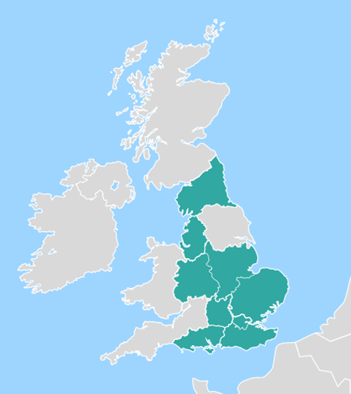
What is Accent Course
Manager?
Course booking management system
Used by you and others to book a place on an event run by NHS England - Midlands
Application for leave (on Leave Manager) is separate to booking a place on an event (on Course Manager)
Only for events organised by NHS England - Midlands
Notes:
Now I’ll give you a brief introduction to Accent Course Manager.
Course Manager is our course booking system; it’s used by learners across the region, as well as consultants, to book places on courses, conferences and meetings run by NHS England East Midlands as well as other regions.
Now it’s currently a separate system, so once you’ve booked onto a course on Course Manager, make sure you submit a leave request for it as well on Leave Manager. Remember, it’s only for events run by NHS England, so you won’t find college courses on there unless we’re running them.

Slide 22





Benefits of Course Manager
Retention of account details – you only register once.
Online evaluation after the event.
Certificates available online.
One stop-shop for NHS England courses.
Streamlined administration = more efficient for staff at NHS England, so we use our time better to support you.
Notes:
What’s good about Course Manager?
Well, like Leave Manager, you only need to register once, and it stays with you throughout your training with NHS England. Because it retains your personal details, you don’t need to provide these every time you book onto a course; you just find the event you want to attend and apply for a place. [CLICK]
It includes an online evaluation system, so you can provide feedback on what was good and bad about the event. [CLICK]
Once you’ve completed the evaluation, your certificate gets released to you. And not by email, so you have to find the email again when you want to add it to your portfolio, but it has a section which stores all of your certificates, so they’re available to you at any time, all in one place. [CLICK]
Finally, it’s a self-contained system; we can quickly add events to Course Manager, and you can find them and book on at any time. You don’t need to email anyone to book your place, and we don’t need to manually email you evaluations or certificates after the event; [CLICK] this means we have more time to support you with queries that actually need a human response!

Slide 23

Need assistance?
If you have difficulties with Course Manager, please let us know!
Contact your named Administrator in the team.
Email the team at england.dwd.midlands@nhs.net
We’re here to support you - if in doubt, please ask!
Notes:
We have a whole team supporting Course Manager, among other things; if you have any queries, you can contact your named administrator directly (who has probably emailed you about upcoming courses or events), or you can email the team directly using the email address on screen. This is monitored by the whole team, so if your admin contact isn’t available, it can usually be picked up by someone else in the team.

Slide 24
Key takeaways
What should you remember?

Slide 25
What should you take away from this induction?
Online Leave Manager system wherever you are.
Funding for curriculum requirements, and appropriate discretionary requests.
Budget of £600 – can request a budget increase
Include expenses with your leave application.
Asking for support is better than struggling.
Leave Manager
Course Manager
Request study leave and/or expenses from your employer.
Address: https://accent.hicom.co.uk/
Portal/Live/Web/
Support: england.studyleave.em@nhs.net
Book onto a course/activity run
by NHS England.
Address:
https://accent.hicom.co.uk/
CourseManager/Live/HEE/Web
Support:
england.dwd.midlands@nhs.net
Notes:
So what should you take away from this. [CLICK]
The online Leave Manager system is available at any time, so no matter where you’re currently training in the East Midlands or where you’re rotating to next, you can apply for study leave. The system will take care of getting approval for you, so you don’t need to email forms or take paper copies around the region to get physical signatures. [Click]
NHS England will support funding for activities that are required parts of your curriculum, as well as for appropriate discretionary and extra-curricular requests. [CLICK]
There is a budget of £600, but you can request a budget increase. [CLICK]
In order to claim those expenses, you must make sure that you include these expenses with your leave application. We encourage you to review our online Study Leave Policy, which has further guidance about how to Add expenses to your leave request, as well as applicable rates and other things to be aware of. [CLICK]
Finally, if you’re struggling, please ask for support sooner rather than later. You get your issues resolved earlier, and it’s easier for you and everyone involved than trying to address things retrospectively, so please contact us if you’re having any issues.

Slide 26
A short summary
https://www.youtube.com/watch?v=-LcwP9H1isA
Notes:
If you want to recap with a short summary video, please visit the link on screen.

Slide 27
End slide
Notes:
Thank you for your time.

